Slide 1
apple pi robotics
9/11/2019

Slide 2
Agenda
What is FIRST
Who is Apple Pi Robotics?
Fall Season
Registration Paperwork & Youth Protection Program (YPP)
Build and Competition Season
Meeting Locations & Logistics
Costs, Sponsors & FUNdraising
Expectations and “Gracious Professionalism”

Slide 3
What is first robotics?

Slide 4
What is First Robotics?
The Mission of First:
FIRST's mission is to inspire young people to be science and technology leaders, by engaging them in exciting mentor-based programs that build science, engineering and technology skills, that inspire innovation, and that foster well-rounded life capabilities including self-confidence, communication, and leadership.

Slide 5
The tiers of first

Slide 6
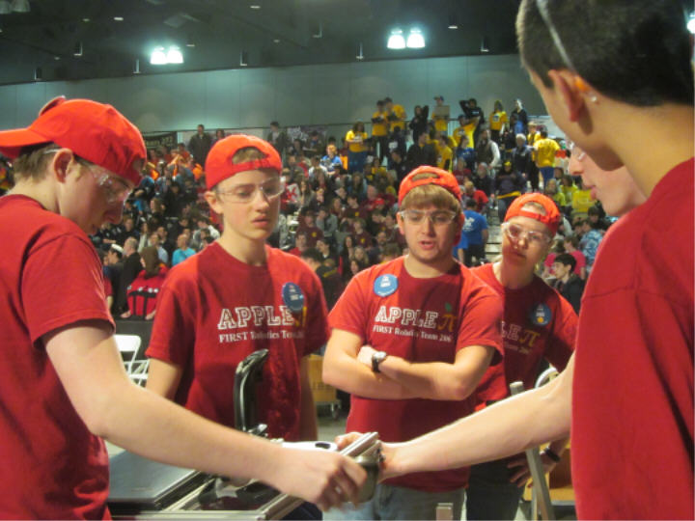
VIDEO
FIRST Robotics Video https://youtu.be/EE-bCy71BJc
Over $24 Million in scholarship opportunities available

Slide 7
A brief history of apple pi

Slide 8
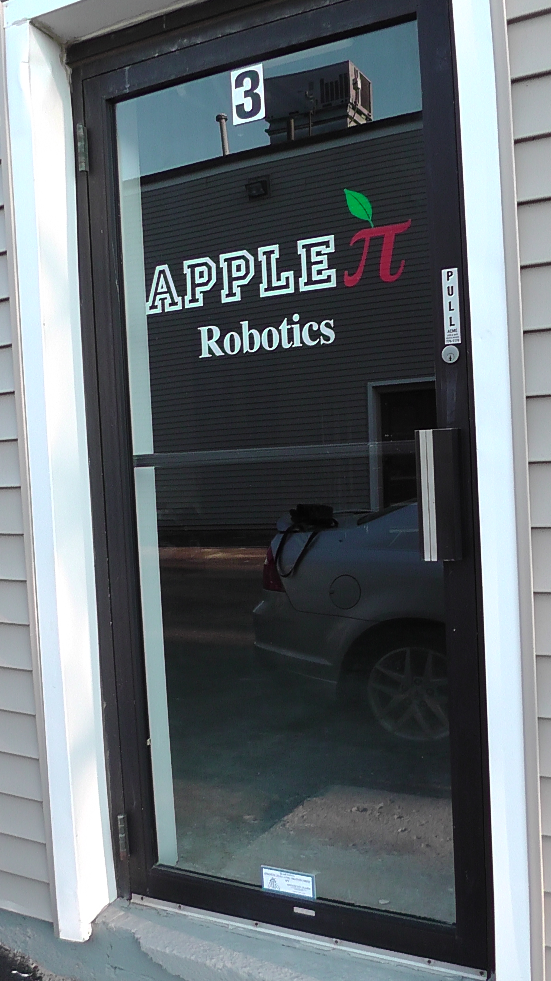
The development of the team
Founded in 2007 by Al Bishop of Bishop's Orchard
Gained support of local businesses and developed key sponsors
Became a 4-H team in 2010
Moved build locations to meet our growing demands -
29 Soundview Rd, Building 2, Unit #3
Continuously grew over the years
2008: 9 students
2019: 50-55 students?

Slide 9
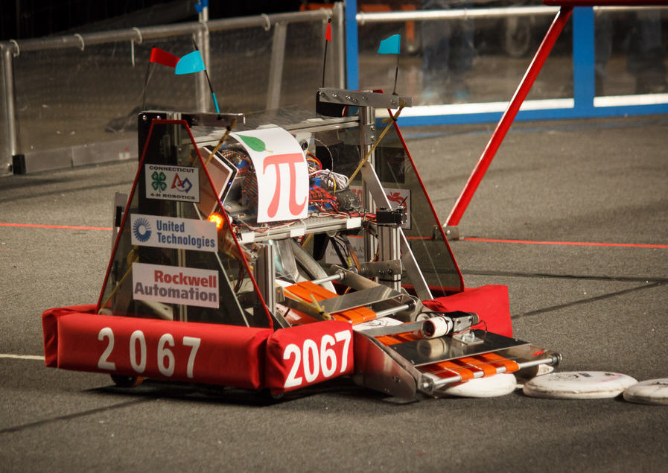
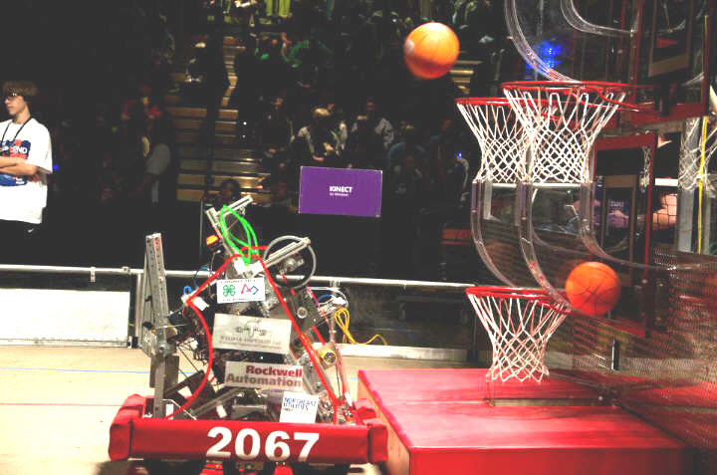
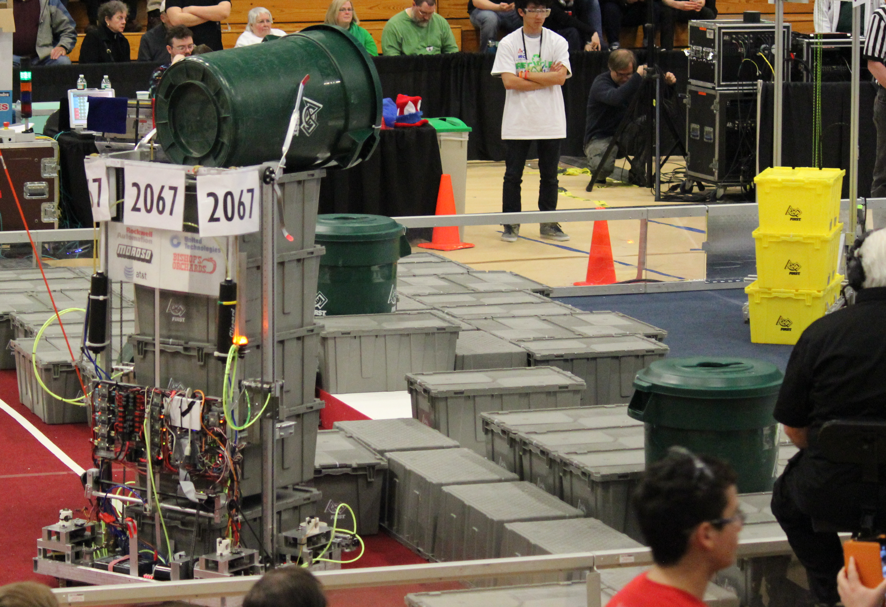
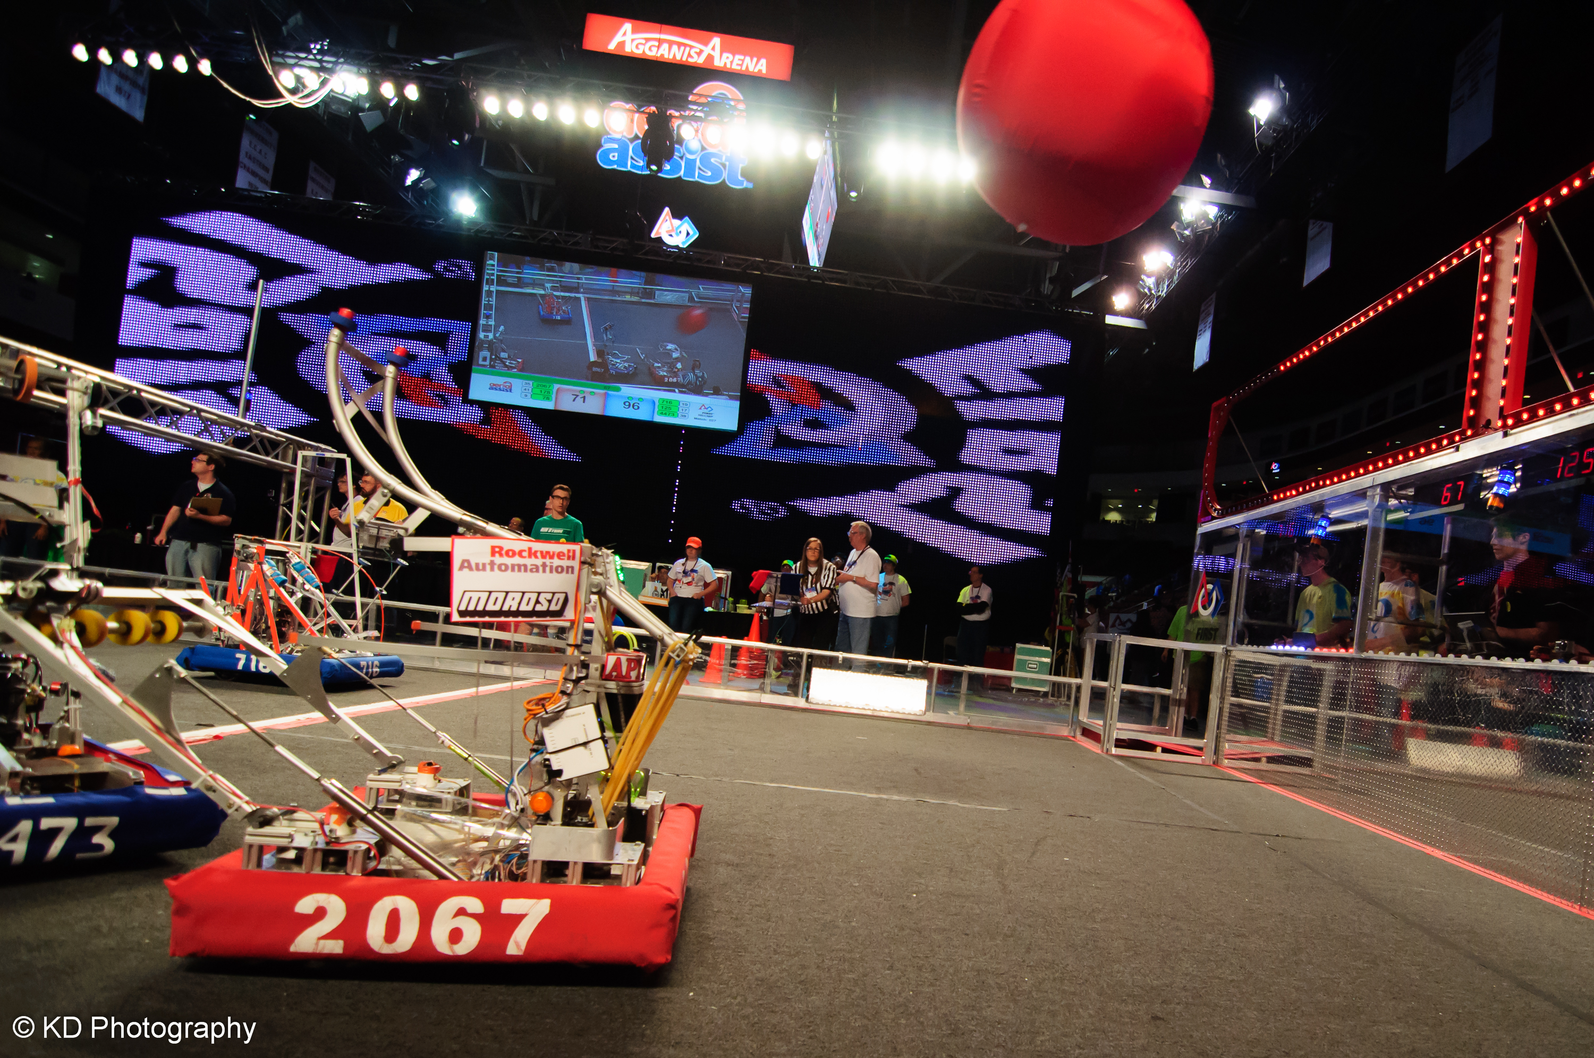
MAJOR ACCOMPLISHMENTS
World Championships 5 of 8 years
World Championship bracket quarterfinalist and semi finalist (2014 and 2015)
New England District Champions 2015
New England Chairman’s Award Winner 2014
Hartford District Chairman’s Award Winner 2014
New England Engineering Inspiration Award 2015, District Engineering Inspiration Award 2019
District Excellence in Engineering Award 2019
District Innovation & Control Award 2018
WPI Regional Champion-2012 & Imagery Award Recipient
State Champions 2015
Numbers of finalist/semi finalist competition awards
First FLL team, now 6 teams
Game Video - https://youtu.be/qCNivnL9xuw

Slide 10
MAJOR ACCOMPLISHMENTS

Slide 11
The season at a glance

Slide 12
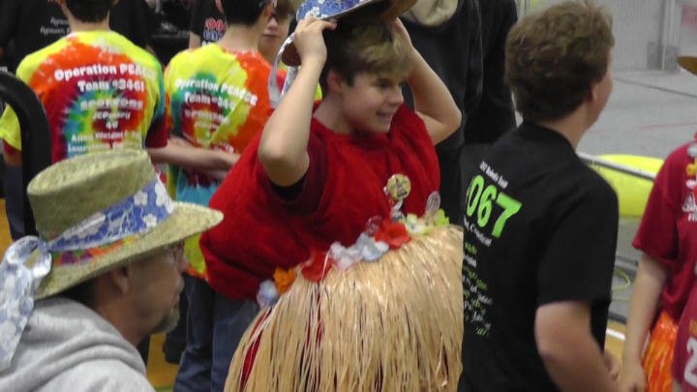
Bash at the beach
All day on Saturday, Oct. 19th at Lyme-Old Lyme HS
Great intro for both parents and students
Exposure to an Event
Fun time in low pressure environment

Slide 13
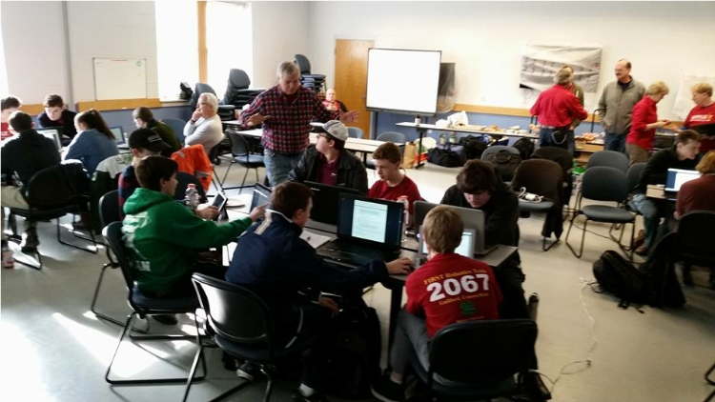
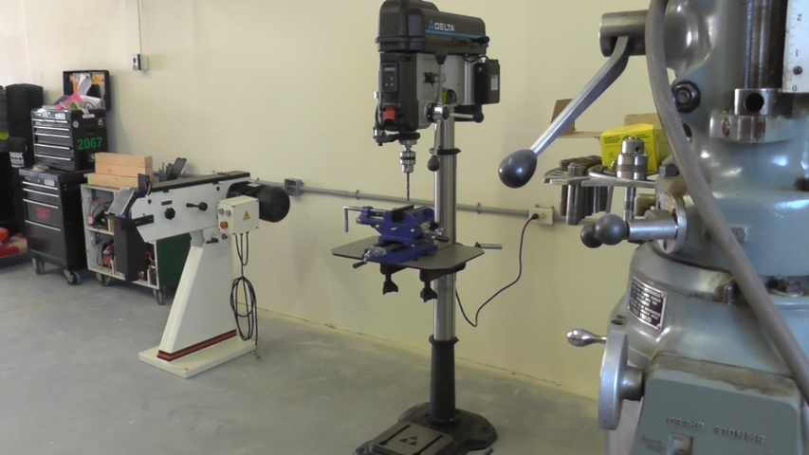
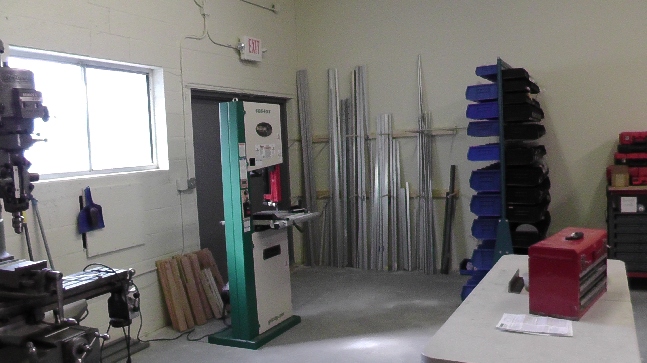
Fall training
Team building, goal setting and group decision making
Shop organization – “Where is the…”
Machinery at shop; hand tools and power equipment - “How do I…”

Slide 14
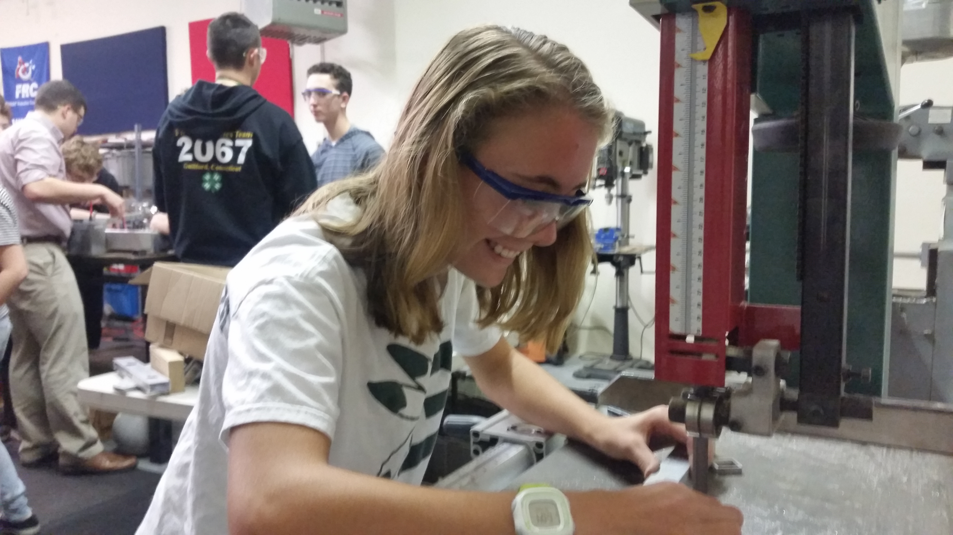
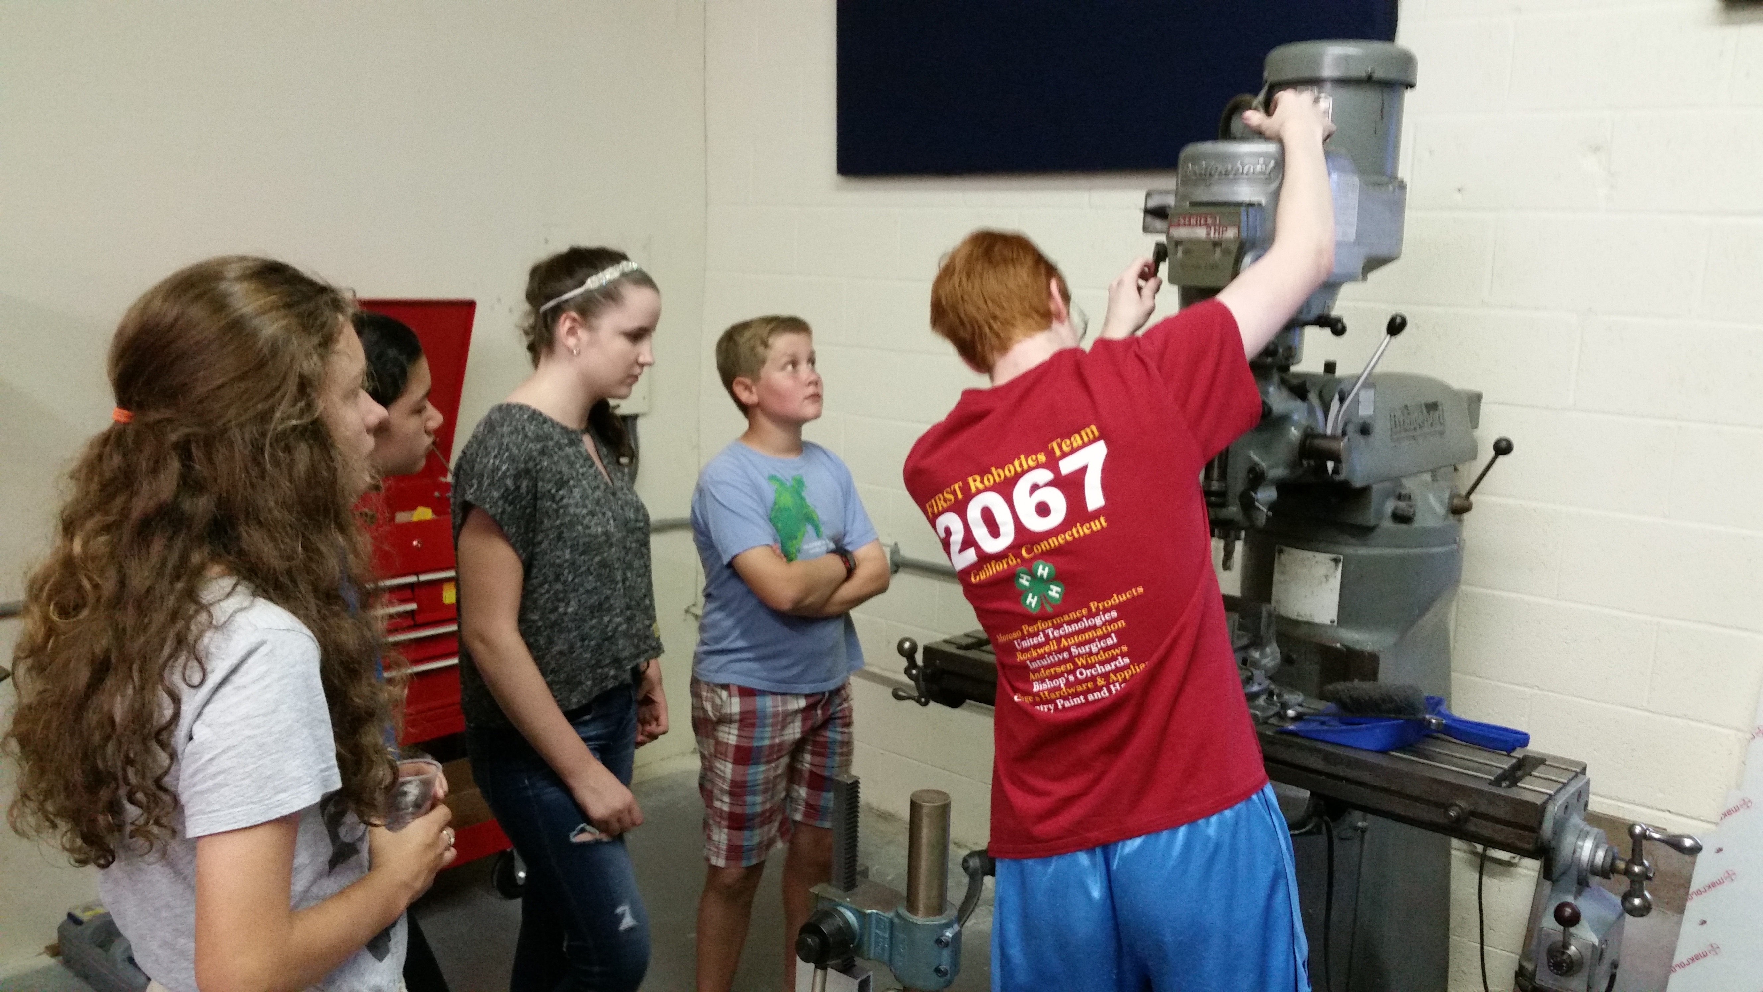
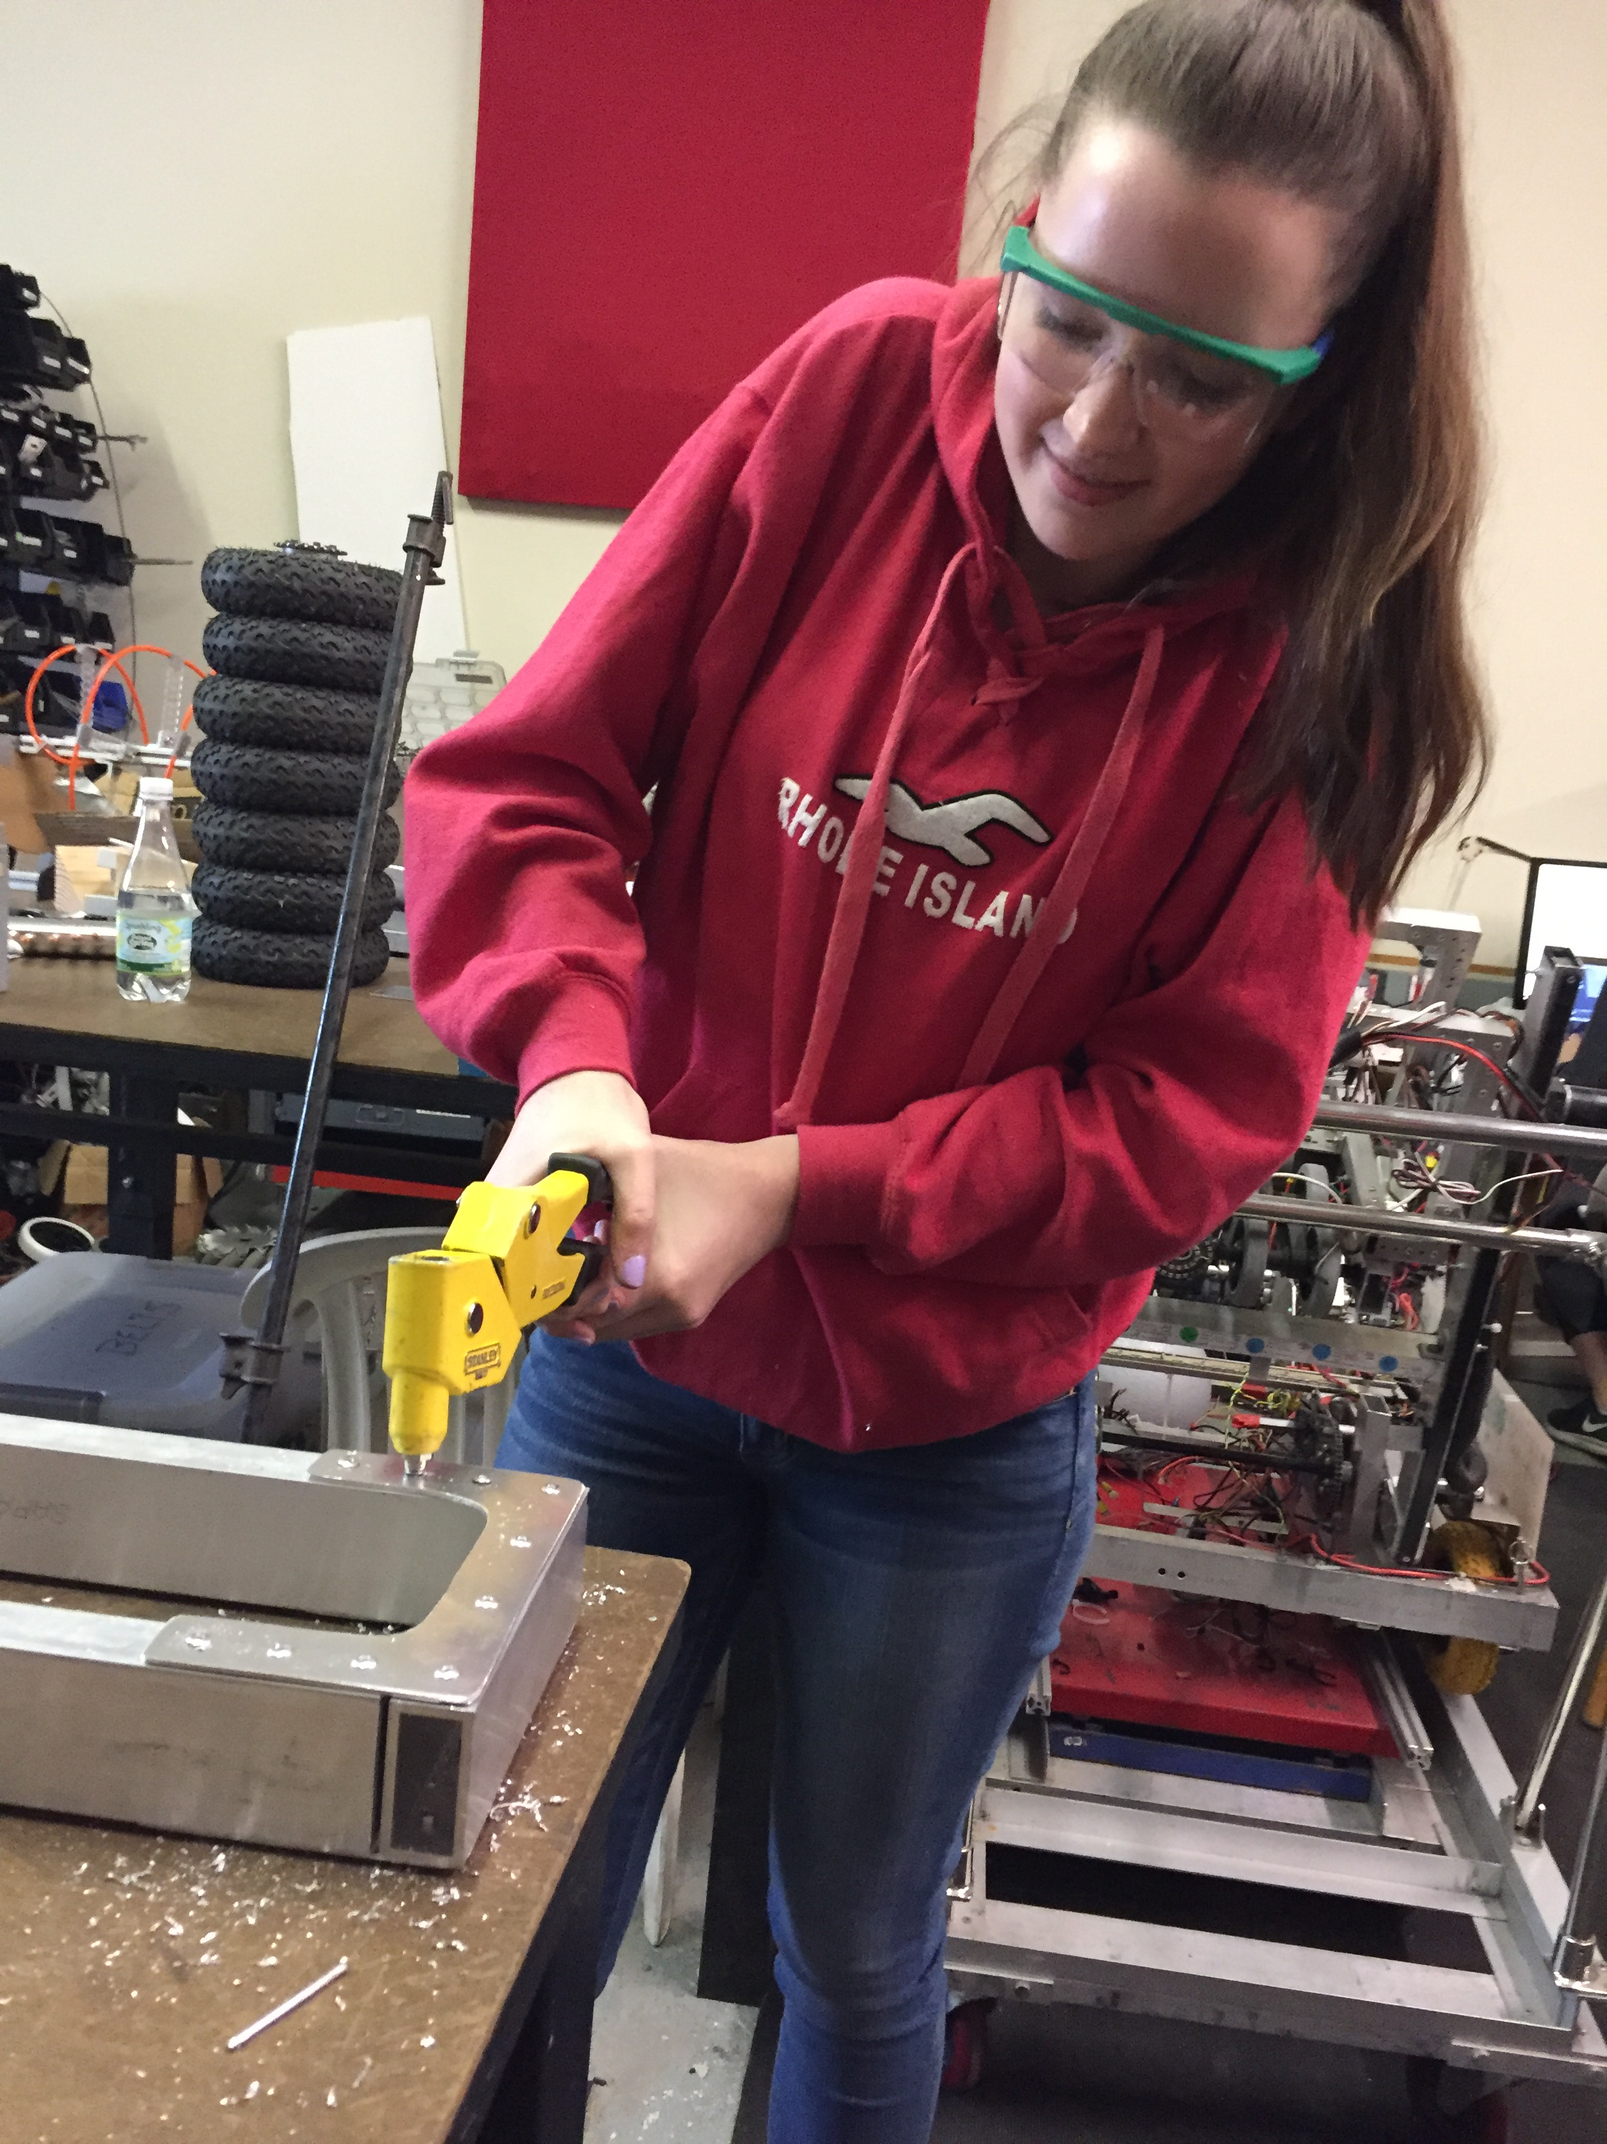
Fall Training
Shop Training
Pre-season
Basic mechanical principles; mechanical advantage, energy, mass, power
Shop machinery – proper use of band saw, Bridgeport, drill press, hand tools
Shop Safety
Tuesday from 5-6:30pm and Wednesdays from 5 to 6:30pm and 6:30-8:00pm

Slide 15
Optional Fall training
Design/Build (training on mechanical systems – Tuesdays)
CAD (Tuesdays 6:30-8:00pm)
Basic Mechanics
Chassis designs, Arm manipulation, Collection system strategies
Electric and Pneumatic Actuators
Control System & Programming (Thursdays)
LabView Training (Beginner and Advanced sessions 6:00-8:00pm)
Basic Machine Logic – Logical thinking
Sensor & Feedback Controls
Camera/Image Recognition
Electrical Wiring and Layouts
Participation in fall program is required!

Slide 16
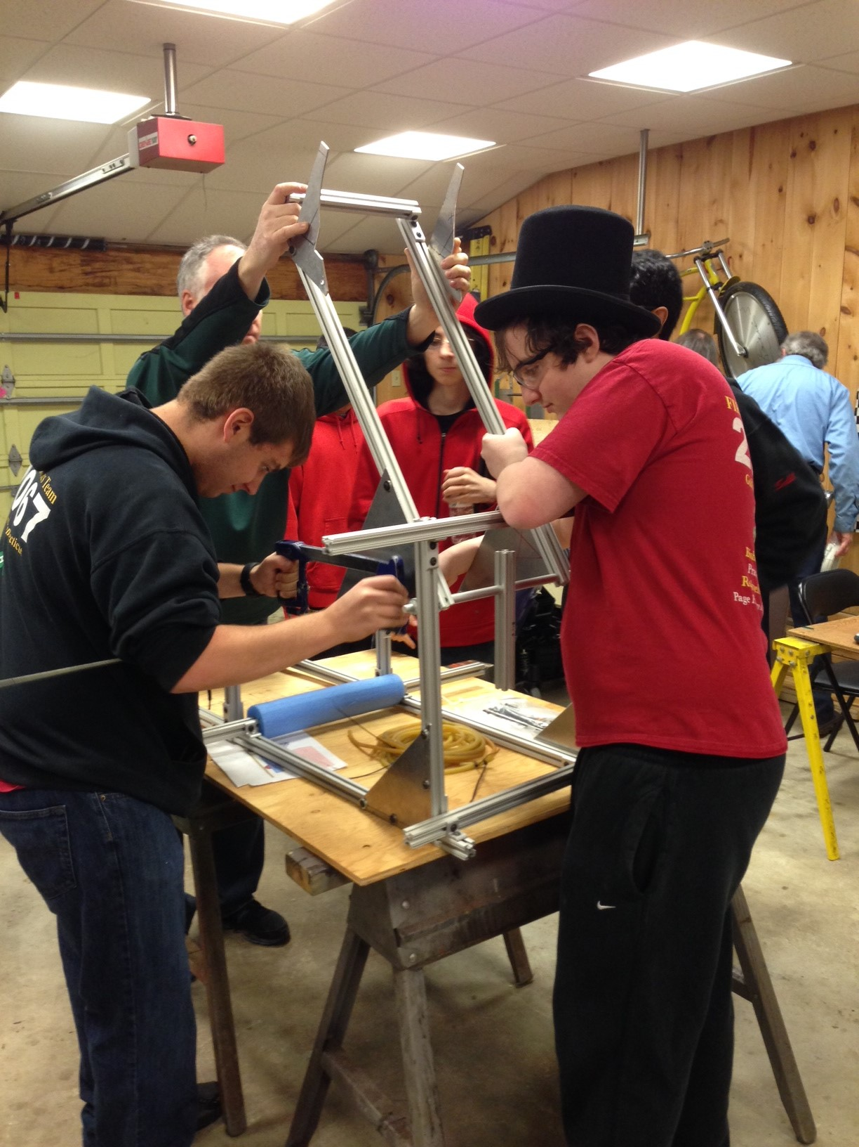
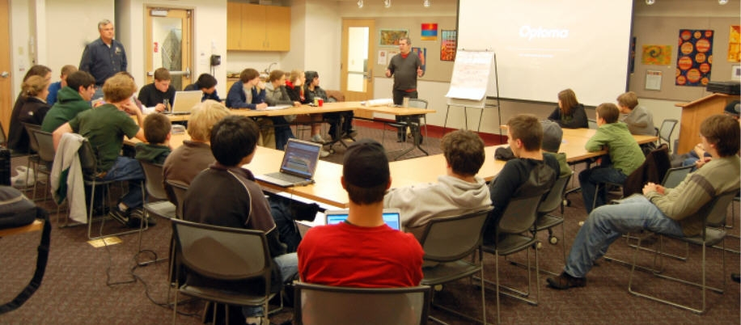
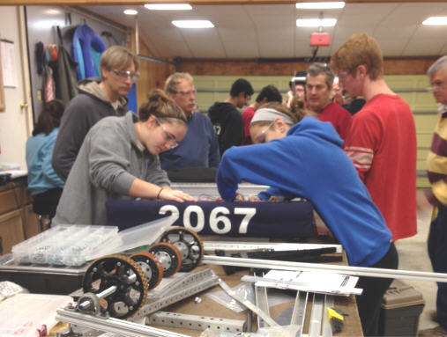
Build season
Six + Weeks of Analyzing, Designing, Building, Testing, and Improving

Slide 17
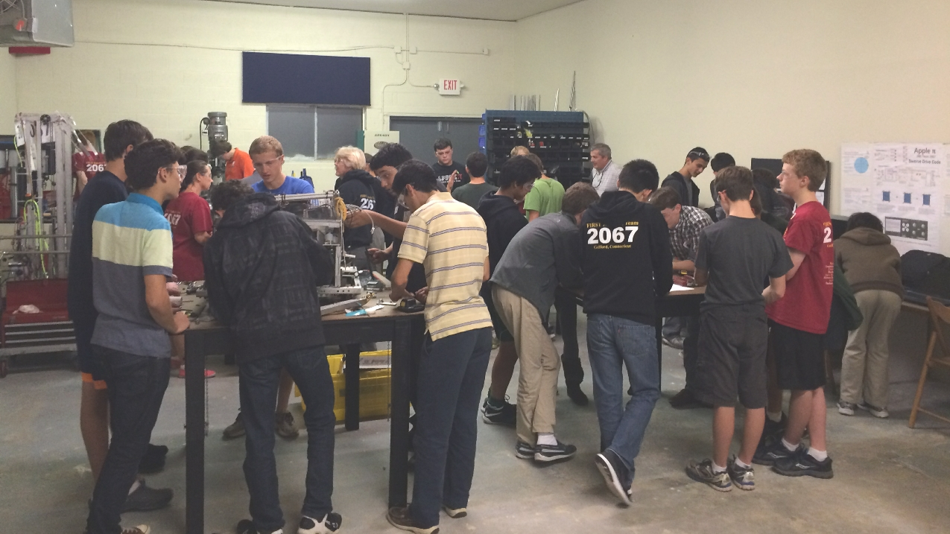
Build Season Meeting times
Meeting Times
Build Season (8 weeks-Jan/Feb) – 2 shifts/day
Mon-Thurs from 5 to 8:30pm
Saturday from 10am to 4pm
Sunday from 11am to 4pm

Slide 18
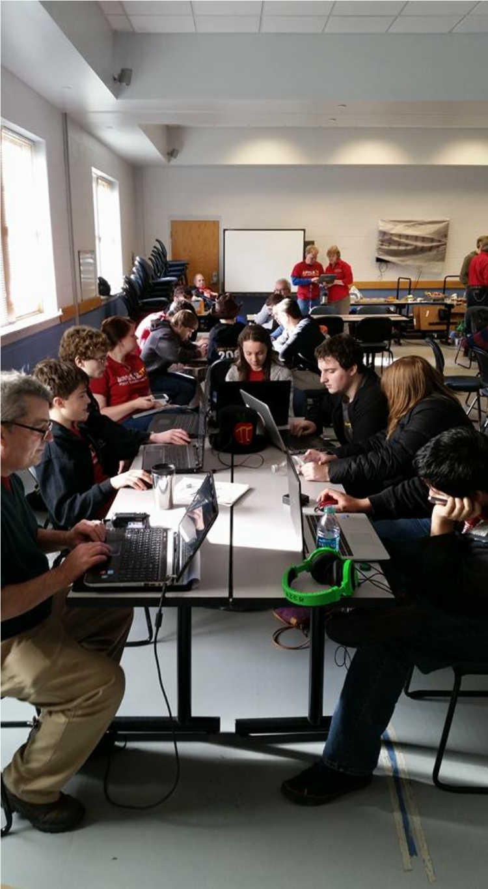
Build season schedule
Jan. 4 – Kick Off – Guilford EMS Building live NASA telecast
2020 ‘game’ objective and rules are presented
First weekend spent analyzing game and finding game strategies
First week spent brainstorming possible designs to satisfy strategies
Robot ready to drive in 4 weeks, ready to play by first event
There is never enough time!
We build two robots – Competition and Driver Training/debugging
Team will divide and conquer
Large team requires two (2) shifts per day with web based sign-up system
Team meets 6 times a week during build season
Each member defines their own schedule – But 2 times/week expected
Video https://youtu.be/GZGC25e3RBA

Slide 19
competition season schedule
Schedule (last year-event dates not posted for 2020 season)
Suffield Shakedown: February, 17th
District Event #1 – Waterbury District, CT (March 9-11)
District Event #2 - Bryant University, RI (March 23 - 25)
District Event #3 – Hartford, CT (April 6 - April 8)
New England Regional – ? (April 13-15)
World Championship - Detroit (April 25-28)
Connecticut Championships (May)
Off Season
Where is Wolcott (June)
Bash at the Beach (October)

Slide 20
Event awards
Competition Awards
Alliance Winner
Alliance Runner-up
FIRST Awards
Chairman's Award
Creativity, Entrepreneurship, Engineering Inspiration, Excellence in Engineering, Innovation in Control, Team Imagery Award, Industrial Design
Media Award – website, videos, Facebook, Twitter
District Points
Points given to winners, runner ups, semi/quarter finalists
Points given based upon selection order & event ranking
Points given for all FIRST awards
Points determine which teams qualify for District Championship and ultimately World Championship

Slide 21
Paperwork, ugh!
4-H Registration
Available after Oct. 1st www.4Honline.com (must be complete before working with heavy equipment)
FIRST Forms
Available at https://my.usfirst.org/stims/
Student registers in Youth Team Member Services Once student has registered, a parent can log on (using email address provided by student) to fill out consent forms (2)
Health Form
Downloadable from our website www.applepirobotics.org (Resources Tab)

Slide 22
Youth protection program

Slide 23
FIRST youth protection program
The purpose of the FIRST Youth Protection Program (FIRST YPP) is to provide Coaches, Mentors, Volunteers, employees, others working in FIRST programs, team members, parents, and guardians of team members with information, guidelines, and procedures to create safe environments for everyone participating in FIRST programs.
Put into effect in 2015
Requires screening for lead mentors
Requires training for all mentors who spend significant time with students
4-H background checks required in addition for all mentors
YPP Video https://www.youtube.com/watch?v=VPzxm4IfG6w&feature=youtu.be&list=UUyJqS0n0h5f3yeYxEADZuvQ

Slide 24
Community

Slide 25
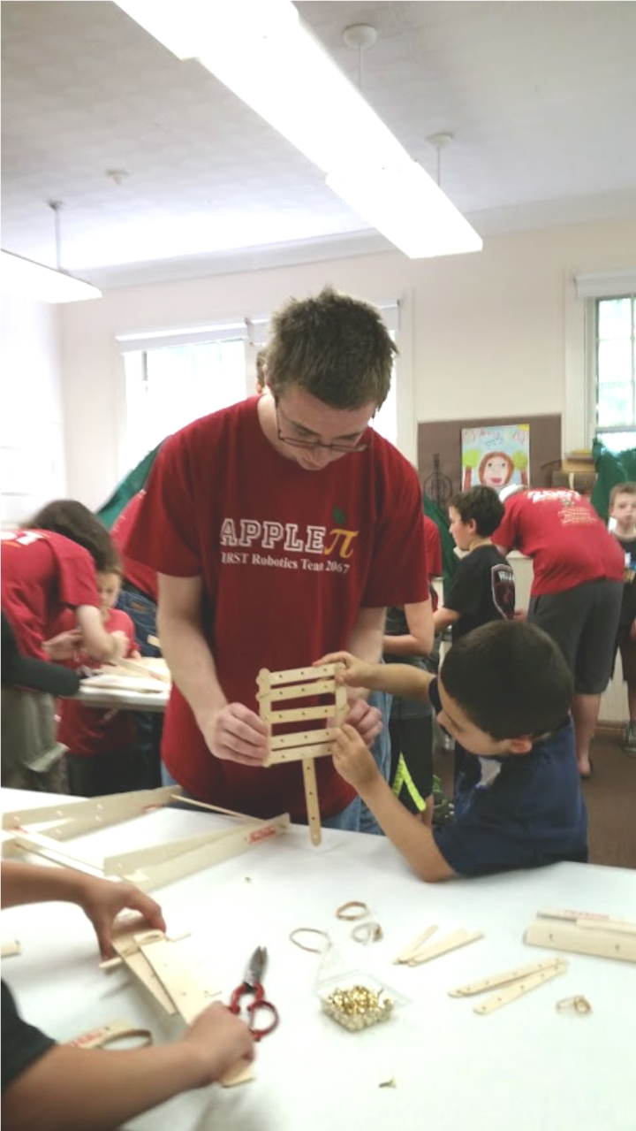
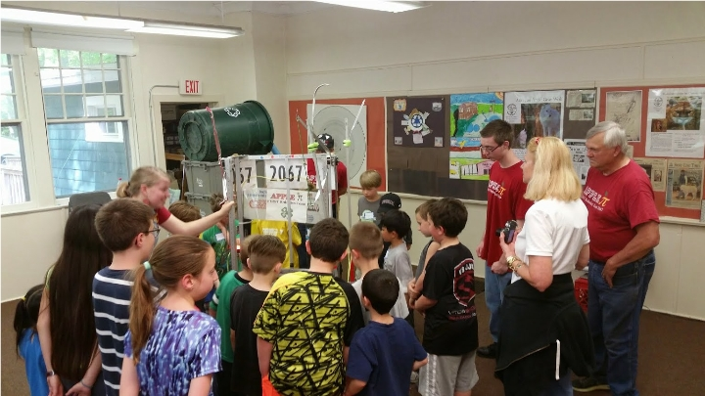
Community outreach
Student presentations and demonstrations for various groups
Brownies, Suncatchers, Guilford Library, Shoreline Outdoor Education Center
Demonstrations at Cruise Nights and “Spooktacular”
Participation in 4-H Fair, Guilford Fair & Durham Fair
Development of FIRST Lego League teams in Guilford and Madison
.

Slide 26
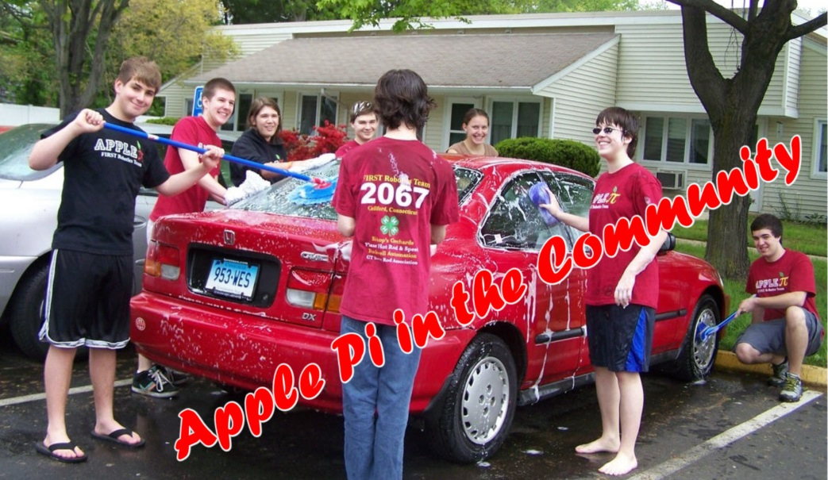
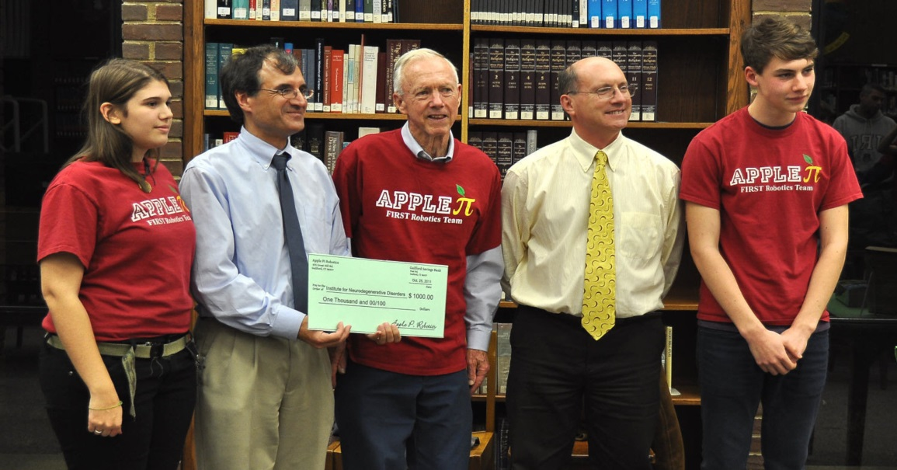
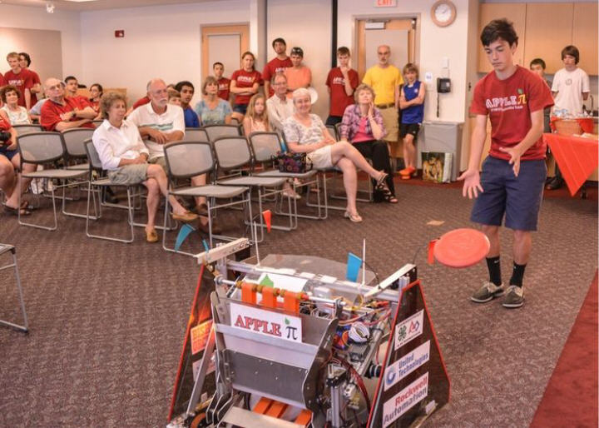
Civic responsibility
Car wash to benefit Parkinson’s Research
Car wash & planter construction for “Guilford House” residents
Coordinated coat drive, board game drive, and book drives
200 LBS of food collected for the Guilford Food Bank
.

Slide 27
Team logistics

Slide 28
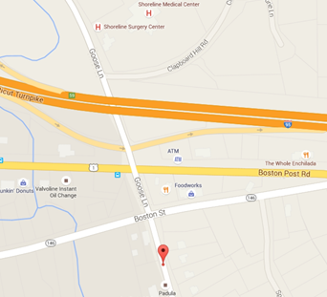
Meeting Locations
Primary Meeting Location
Workshop – 29 Soundview Road, Building 2, Unit #3, Guilford
Secondary Meeting Locations
Guilford Free Library
Emergency Services Building – behind Police Station, adjacent to Firehouse
Guilford High School (Occasional Team meetings)

Slide 29
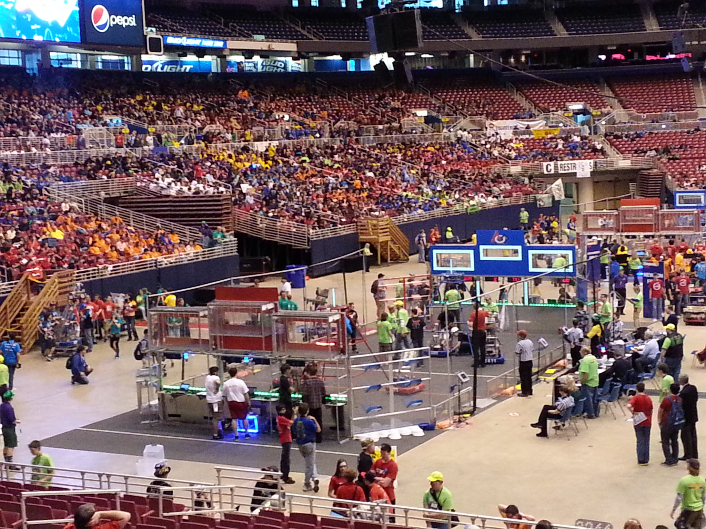
Competition travel & cost logistics
In-state Events
Carpool each day
Team covers costs except for food
New England Out of State Events
Carpool to and from
Hotel overnights required
Approx. $100-$200/student
Championship Event (Detroit)
Air travel
Hotel for four (4) nights
Food
Approx. $800/student

Slide 30
opportunity to offset costs
Special Student Fundraisers (% contributes to student travel costs)
Selected Car Washes (75%) divided among attendees
Thanksgiving Pie Sales (100% of profits/$5 per pie)

Slide 31
Team Costs and income
Annual Budget of Approximately $35-40K Not Including Travel
Bulk costs (75% of budget) covered by sponsors
Bishop’s Orchard (Founding Sponsor)
United Technologies
Rockwell Automation
Lockheed-Martin/Sikorsky Aircraft
Intuitive Surgical
Medtronic
Moroso Performance Products
Page’s Hardware
Country Paint & Hardware
Team contribution covers remaining 25%
Classic Car Cruise Ins
Member Fees - $150/Student Due Nov. 15, Late? - $200
Car Washes
NEW – “The Great Give”

Slide 32
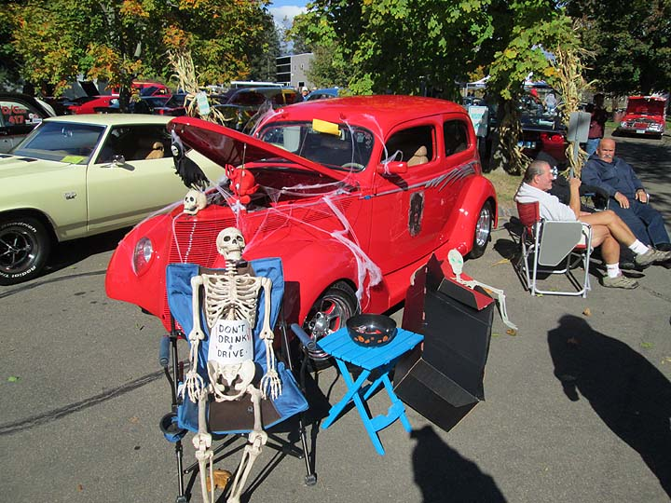
Team Costs and income
“SPOOKTACULAR”
October 26th – (rain date Oct. 27
Classic Car Cruise In
Moroso Performance Products
Cars – BBQ – MUSIC – ROBOTS
Premier fundraiser - $$

Slide 33
The Great Give
The Great Give:
Takes place end of April/Early May weekend
Coordinates donations to New Haven area non-Profits
2 years ago we obtained $1800 – This next year we need to get $10,000
Need students and parents to market this – this is key to sustainment of our team
GaelHawks (Shelton Robotics Team) receive over $25,000 through successful implementation
https://www.thegreatgive.org/organizations/shelton-high-school-robotics-team

Slide 34
communications
Website – www.ApplePiRobotics.org
Apple Pi Robotics team calendar at: http://www.applepirobotics.org/calendar/
General updates from Gmail – ApplePiRobotics4h@gmail.com (do not reply)
Important emails for contact
Mentor Emails
Jim Scott – Capnhook-41@comcast.net General
Rick Page – rick.page.home@gmail.com General
Diane VanderGrinten – dvandergrinten10@gmail.com Financial & Travel Coordination, FLL

Slide 35
Our expectations

Slide 36
expectations
Focus on task at hand when at Apple Pi
Work safely at the shop
Be patient as you learn certain procedures from experienced team members – often “learning by watching”
Be open to contributing to tasks outside of the robot build process
Meaningful participation – engaged at least twice/week during build season
Regular attendee at training sessions in the fall season

Slide 37
Parent assistance
Carpool driving assistance
Provide assistance with fundraisers
Timely drop-offs and pick-ups for team events and shop sessions
Provide assistance with getting all forms and registrations done before deadlines
Occasionally we will ask for nominal donations of snacks, baked goods or other food/beverage items to be used at events
“Spooktacular” Cruise; we need grill hand, cashiers, parking assistants, etc. Donated and loaned items – signup list will be forthcoming
Do you work for a company that would contribute/or match contribution?

Slide 38
Gracious professionalism
"Competition, not for the sake of destroying one another,
but for the sake of bettering and improving both
competitors as the end result."
https://www.youtube.com/watch?v=PCGsLAyrck4

Slide 39
Wednesday – 9/25
Don’t Forget - Drop in Open House at the Shop
Wednesday, 9/25, 6-8pm
Come see the place your children will spend lots of time at during the season – New Recruits & Parents

Slide 40
Questions?
Apple Pi FUN Video

