Slide 1
Apple Π Robotics Introduction for New Recruits 9-12-18

Slide 2
Apple Pi Robotics
Agenda:
Introductions
What is FIRST (Video)
Who is Apple Pi Robotics?
Season at a Glance
Meeting Locations
Costs & FUNdraising
Notes:
2
2
2
2

Slide 3
Apple Pi Robotics
Introductions:
Suggested Content:
Name
Grade
Hobbies? Sports?
What interesting or different thing did you do this summer?
How did you find out about Apple Pi?
What do you want to do or learn here?
Notes:
3
3
3
3

Slide 4
We build robots to Compete in the FIRST Robotics Challenge
Over 50 high school age teams in CT
Over 210 teams in the NE District
Over 3500 teams worldwide
Play FIRST Video
https://youtu.be/EE-bCy71BJc
Notes:
4
4
4

Slide 5
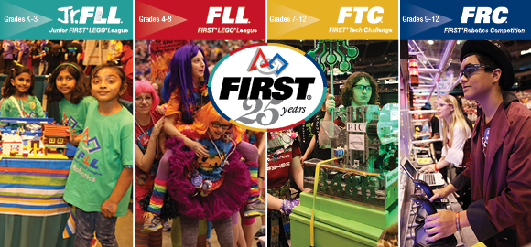
What is FIRST and Apple Pi Robotics?
Apple Pi Robotics' mission parallels that of FIRST Robotics -
"FIRST's mission is to inspire young people to be science and technology leaders, by engaging them in exciting mentor-based programs that build science, engineering and technology skills, that inspire innovation, and that foster well-rounded life capabilities including self-confidence, communication, and leadership."
Notes:
5
5
5

Slide 6
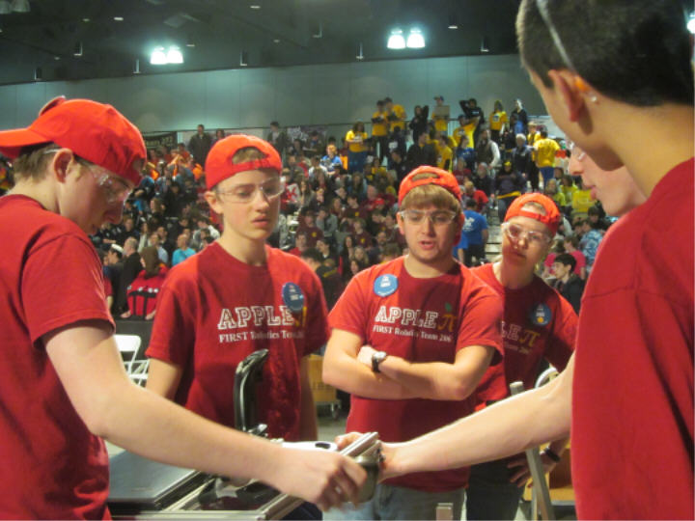
What is FIRST and Apple Pi Robotics?
How?
We build robots to compete at the top levels of FIRST Robotics Competition comprised of over 3500 teams in > 40 countries around the world
We do this as a team, unified in our goals
Working together: we analyze the game
Design and build a winning robot, and design and build a robot to execute and winning strategy
We continue to develop improvements and train during the competition season
It is the hardest Fun you will have
Notes:
6
6
6

Slide 7
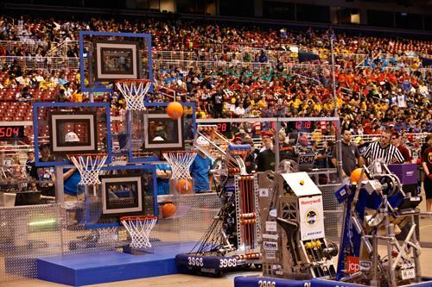
What is FIRST and Apple Pi Robotics?
What do we do:
Train in the Fall – Robot building skills & building a team
Receive new game rules: January 5, 2019
Game strategies, design and build robot in 6 weeks
Compete:
3 x 2 day district events – 2 in CT (likely) and 1 overnight (RI or MA)
Win eligibility to New England District Championships (TBD)
Win eligibility to World championships
Detroit, MI
600 teams from around world
4 day event
Notes:
7
7
7

Slide 8
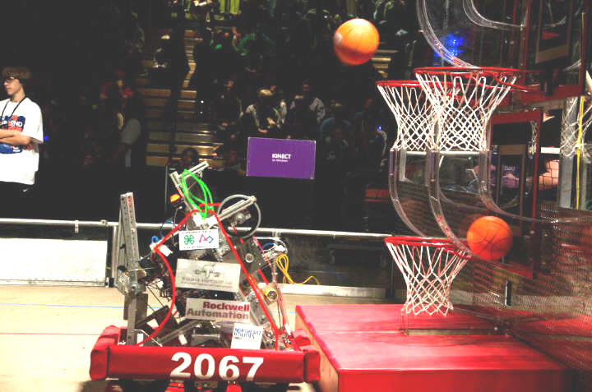
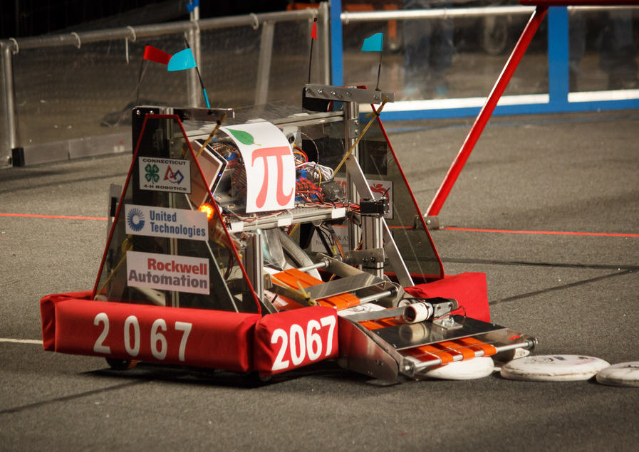
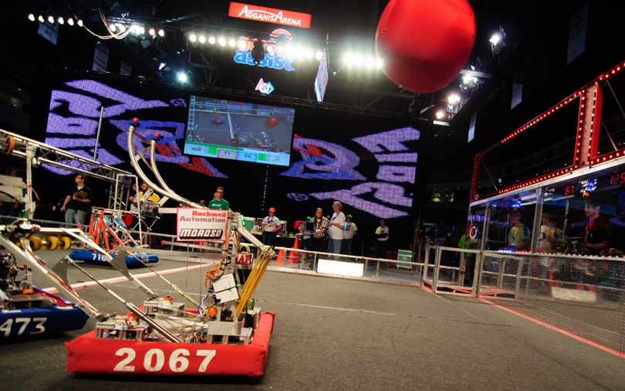
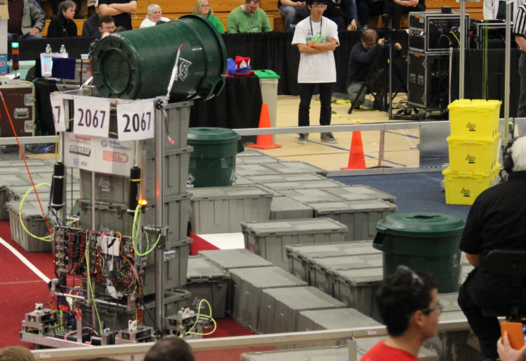
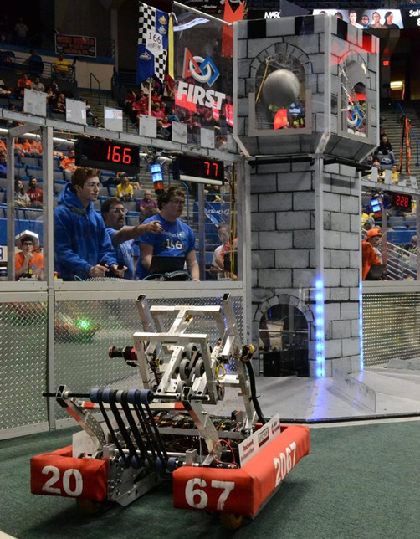
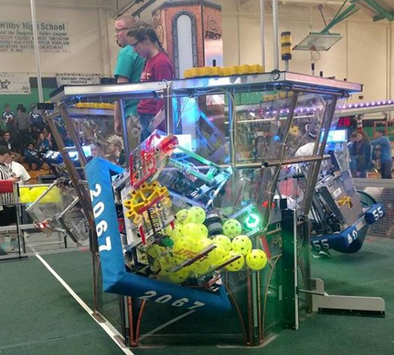
2012 - 2018 Competition Through the Years
2012: WPI Regional Winner, World Champs Qualified
2013: Hartford Regional Finalist
2014: District Semifinals, NEDCMP Chairman’s Award Winner, World Champs Qualified
2015: District Finalist, NEDCMP Champions, EI Winner, World Champ SemiFinalist, CT Champs Winner
2016: District Semifinals, NEDCMP QF & EI award, Worlds Champs QF
2017: District SemiF, NEDCMP Excellence in Engineering Award, World Champs Qualified
2018: District Semis, NEDCMP Engineering Inspiration Award, World Champs Qualified
1 of only 7 out of 201 NE teams to qualify for World Champs each year since 2014 - start of District qualifying

Slide 9
Season at a Glance - Fall Competition
“Bash at the Beach !” – Oct. 13th – Saturday – all day
Off-season competition, 2018 year game & robot,
Great intro (Parents encouraged to come)
See other teams and their robots
Video of 2018 Game rules:
Video of “IRI” Finals
https://www.youtube.com/watch?v=HZbdwYiCY74
https://www.youtube.com/watch?v=Fj9_jFqcuOM&index=3&list=PLnNxQYk6vza9DC7y2VX9rQCjtKru6RzkX
Notes:
9
9
9

Slide 10
Fall Training - Hands-on - all at Shop
Shop And Mechanics (all Students expected to attend )
3 sessions: Tues 5:00-6:30, Wednesday 5:00-6:30, & 6:30-8:00
Robot construction techniques
Mechanics principles to aid in Robot design
Returning students will help train new students and/or advance their own skills
Robot Design and CAD / CAM
Tuesday: 6:30 to 8:00
Solidworks CAD program usage
FRC Robot design principles and considerations
Basic Mechanics principles
Chassis and drive system design, including gearbox design
CAM - use of 3D Printer and CNC router
Robot Control and Labview Programming
Thursday: 6:00 to 8:00
Setup of control system, On robot and driver station
Labview programming, tele-op and autonomous control of drive and manipulators
Use of sensors and feedback control
Notes:
10
10
10

Slide 11
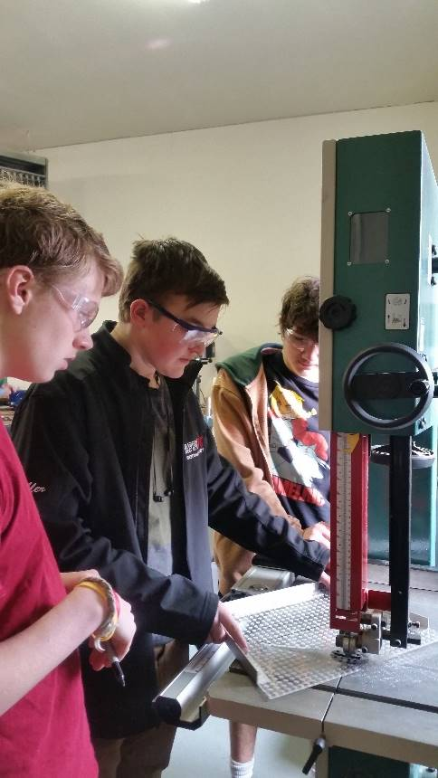
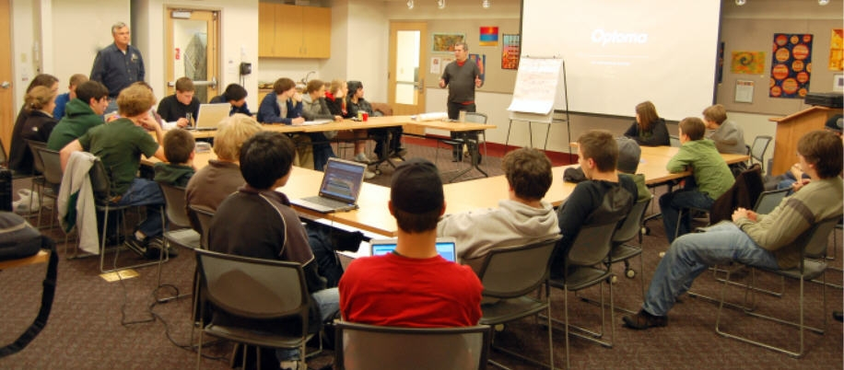
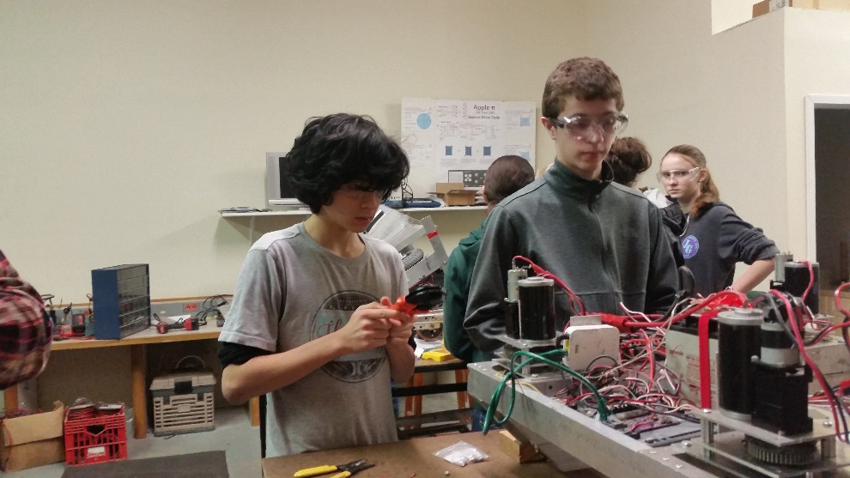
Build Season - 1/5/19 - 2/19/19
“Build” Season – 6 Weeks
Never enough time!
Analyze, Design, Build, Test, Train, Improve
Will require consistent meeting to maintain progress
Team meets 6 days per week, 2 sessions per day
Expect to attend a minimum of 2, average of 3 sessions per week
Notes:
11
11
11

Slide 12
Build Season - 1/5/19 - 2/19/19
Jan. 5th – Kick Off – Guilford EMS Building live NASA feed
2019 ‘game’ objective and rules will be presented
First weekend spent analyzing game and finding game strategies
First week spent brainstorming possible designs to satisfy strategies
Prototyping by next weekend
Robot ships February 19th
There is not enough time!
Work continues after ship on back-up robot, + drive training
Team will divide and conquer
Large team requires two (2) shifts per day of meeting
Web based sign-up system
Team meets 6 days a week
Each member defines their own schedule/commitment
Minimum expectation of engaging in 2 sessions per week
Notes:
12
12
12

Slide 13
Competition Season
Competition Season – March-April
- Plan to compete in 3 District Events (one overnight)
- New England Regional Championship (if we qualify)
- National Championship in Detroit (if we qualify and can raise money)
Schedule (Very Preliminary):
Wolcott (?) Shakedown: February 16(?)
District Event #1 – Waterbury, CT (March 8-10)
District Event #2 - Bryant University, RI, or Western New England University (March 22 - 24)
District Event #3 – Hartford, CT (April 5-April 7)
New England Regional (April 12 -14) WPI
Detroit World Championships (April 24-27)
Connecticut Championships (May)
Off Season:
“Where is Wolcott” (June)
“Bash at the Beach” (October)
Notes:
13
13
13

Slide 14
Event Awards
District and Regional Alliance Winners & Runner-up
Alliance Winner
Alliance Runner-up
Points for Quarter and Semi Finalists
FIRST Awards
Chairman's Award
Engineering Inspiration, Entrepeneurship
Excellence in Engineering, Quality, Creativity, Innovation in Control, Team Imagery Award, Industrial Design, Spirit, Safety
Safety Animation Award - Fall
Notes:
14
14
14

Slide 15
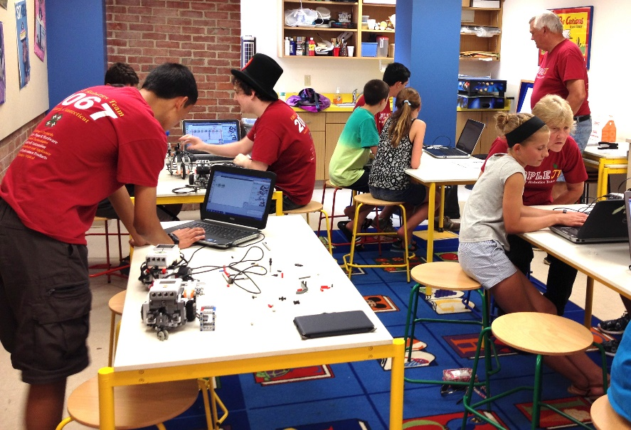
Community Outreach
Initiatives:
Student presentations and demos for various groups; Brownies, Suncatchers, Guilford Library, Outdoor Ed. Center
Cruise Nights Demos and Music
4H County + Guilford Fairs
Development of FIRST Lego League teams
Now over 50 students on ~10 teams
Opportunity for mentoring and or helping at competitions
.
Notes:
15
15
15

Slide 16
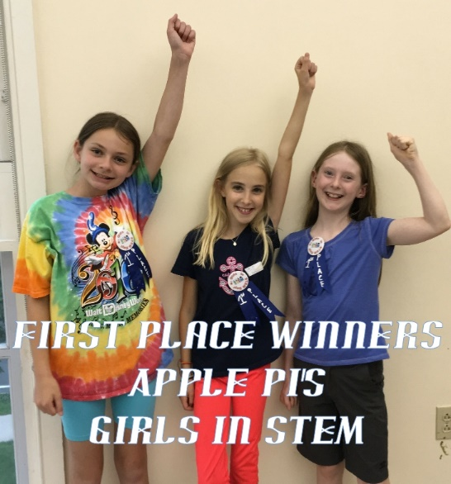
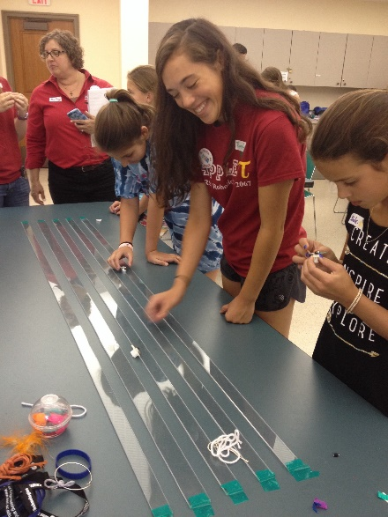
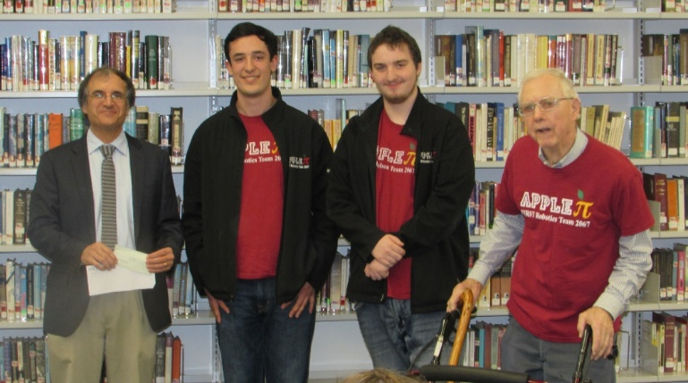
Civic Responsibility
We also Give Back to the Community that supports us
Community Service Examples:
“Tech Tuesdays” and “Girls in STEM”
Student run STEM program for middle school age
held at Guilford Public Library & Community Center during summers
Institute for Neurological Disorders Benefit
Dedicated “Cruise Night” to raise donation for Parkinson’s research.
Winter clothing drive, book drives
Notes:
16
16
16

Slide 17
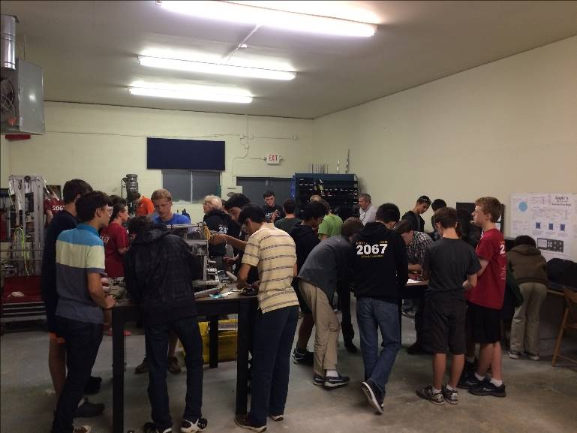
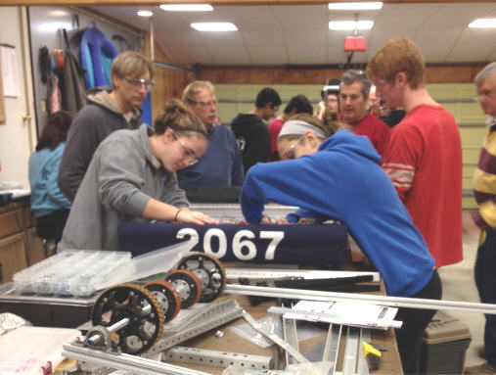
Meeting Locations/Times
Primary meeting location:
Apple Pi Robotics Shop
29 Soundview Rd., Guilford
Open House (Tues. Sept. 18th, 6-8pm)
Other sites sometimes used:
Guilford Public Library
Emergency Services Building
GHS
Web-site Calendar will keep up to date meeting times/locations
Notes:
17
17
17

Slide 18
Competitions: Travel Logistics & Costs:
In State Events
Carpool each day
Team covers costs except food
New England Out of State Events
Carpool to and from
Overnights required (cost estimate $100 each night – covers food/lodging)
Championship Event (Detroit)
Air Travel
Hotel 3 nights,
Cost – estimated ~$800 / Student fund raising opportunities can defray some cost
Notes:
18
18
18

Slide 19
Costs/Fundraising
Team costs are ~ $30-35K / year - Yes it is expensive overall
Not including hotel & travel costs
Bulk of costs (75%) for registration of events, and parts covered by sponsors:
Bishop’s Orchards (Founding sponsor)
United Technologies
Rockwell Automation
Moroso
Lockheed Martin/Sikorsky
Intuitive Surgical
Medtronic
Pa’s Place
Page Hardware
Country Paint Hardware
Team Participation Fundraising is significant (25%)
Examples include:
Cruise Nights & “Spooktacular”
Car Washes
Thanksgiving Pie Sales, BATB Concession
Fundraising also to raise $ for Travel costs
Notes:
19
19
19

Slide 20
Costs/Fundraising
Special Student Fundraisers – 75% contributes to students travel costs
Selected Car Washes
New team sponsors ( a percentage?)
Student Commitment Fee
$100 requested to go largely toward team issued shirt and safety glasses, and food during the year
Notes:
20
20
20

Slide 21
Communications
Multiple communication platforms:
Google Classroom
You will be invited to Apple Pi classes
Team Calendar Notifications
You will get Invitation from Apple Pi Robotics at Yahoo Group
You will need a Yahoo account – but you don't need to use it
Link your email address where you want notifications sent
Team Emails
Will come from: applepirobotics@juno.com
Do not reply: We DON'T READ emails sent to this account
Communicate directly to a mentor/team
Team Website:
applepirobotics.org
Videos, resources, technical and general, Team Handbook and more
Notes:
21
21
21

Slide 22
Gracious Professionalism
https://www.youtube.com/watch?v=PCGsLAyrck4
"Competition for the sake not of destroying one another,
but for the sake of bettering and improving both
competitors as a result of the competition."
Notes:
22
22
22

Slide 23
Our Expectations
Skilled in Calculus
CAD proficient
Able to program in 2 or 3 computer languages
Working knowledge of Einstein's “Theory of Relativity”
Notes:
23
23
23

Slide 24
Our Expectations
No prior knowledge required, but must have interest and desire to learn!
Focus on task at hand when at Apple Pi
Work safely at the shop
In many cases you will begin training by watching; be patient!
Be open to doing tasks outside the actual robot building process – We are a team and need blockers, tacklers, running backs and kickers to succeed
Meaningful participation – engaged at least twice/week during build season.
Regular attendee at training sessions in the fall season
Notes:
24
24
24

Slide 25
We are glad to have your interest! Excited for New Year! New Adventures New Fun

