Slide 1
Apple Pi Team Roster
Sean Hackett
Cory Lynch
Sam Westgard
Matthew Moroso
Eric Kostoss
Benjamin Klemme
Sam Zimmerman Aaron Marselli
Sam Jelley
James O’Connor
Michael Lu
Zach Moskow
Chris Garuti
Sam Weeden
Gavin Popkin Jeanne Johnson
Ian Ghoreyeb
John Lemoine
Jonathan Hubbs
Michaela Marinis
Samantha Stofflet Andrew Chapman
Andre Dugas
Beth Prendergast
Brandon Mellilo
Dexin Huang
Ethan Silver
Heather Goodman
Kyle Dunlop
Leo Westgard
Luis Martinez
Owen Dray
Renee Sanacora
Tyler Sloss
Zach Hilmer
Zach Wang Brandon Vitale Harriet Anderson Dina Alnabulsi Kaitlyn Sandor Petra Sestan Bradley Stutzman Matt Kornitsky
    IF YOU DON’T SEE YOUR NAME HERE…. YOU HAVE A PROBLEM!

Slide 2
Agenda
FIRST Youth Protection Program
Kickoff Weekend - How does it work?
Conceptual Design Sessions – Monday/Tuesday
    Where Robot Attributes and Design Align
Apple Pi FRC Design Guide
    What have we learned in 9 years?
Qualifications for Travel Team
Shop Protocols

Slide 3
FIRST Youth Protection Program
The purpose of the FIRST Youth Protection Program (FIRST YPP) is to provide Coaches, Mentors, Volunteers, employees, others working in FIRST programs, team members, parents, and guardians of team members with information, guidelines, and procedures to create safe environments for everyone participating in FIRST programs.
https://www.youtube.com/watch?v=VPzxm4IfG6w&feature=youtu.be&list=UUyJqS0n0h5f3yeYxEADZuvQ

Slide 4

Goals: Let’s Aim High!
Designing and building a cool robot is a lot of fun.
Designing and building a cool robot that does well in competition is even more fun!
        http://www.simbotics.org/files/pdf/effective_first_strategies.pdf
Apple Pi approach is to aim for maximum fun.
        While inspiring STEM learning
  To be a competitive team we need:
  Good Strategy (Game, Design, Match)
  Good Robot
  Good Drivers
  It’s not luck

Slide 5
Kick Off Plan Day #1:
EMS Building –
    Saturday – 9:30am – 5pm
    Broadcast starts at 10am
      Dean, Woodie and others will talk… and talk and talk
      Game committee will say a few words…
      Game Animation video (3 minutes)
      De-encryption key for game manuals will be provided
      Game committee will likely provide more details and “field tour”
      Broadcast will end at about 11:30am

Slide 6
Kick Off Plan:
After formal broadcast we will –
    Review animation – once, maybe twice
    Review field walk-through
    De-encrypt game manual (de-encrypt key provided end of animation)
    Break into sub-teams to evaluate Field, Game and Robot documents and prepare to report findings to entire team – Focus on “What’s New”
      You MUST prepare by becoming familiar with last years’ game manual
      At same time - “working lunch” Use time to begin reading assigned section
    Save presentations on thumb drives. Load presentations into Google Docs for sharing and use during presentation
    Complete by 2pm-2:30pm
    Presentations (2-2:30pm)-(3-4:00pm)

Slide 7
Kick Off Plan:
Begin game analysis (4pm?) –
    How to score? Multiple ways
    Scoring strategies? There will be several
    Alliance teamwork? Last year very important, other years to varying degrees
    Defenses?
    Points needed to win? Early season? Late season?
    Killer penalties?
    Possible “Game Breaking” strategies?
    Get a look at game pieces
  Homework - Read ENTIRE game documents. All must be familiar!
  END DAY 1

Slide 8
Kick Off Plan Day #2:
EMS Building –
    Sunday: 12noon – 5pm
    Eat late breakfast/lunch beforehand. No FREE LUNCH TODAY!
  Review game documents – Anything new from last nights’ homework?? There almost always is!
  Review interesting postings from Chief Delphi
  Review our game analysis findings (from yesterday); ie. scoring, strategies, defenses. Etc.
      Make changes where appropriate
  Discuss game strategy for max. points – Set preliminary direction?
  Robot attributes required to align with game strategy
    Prioritized

Slide 9
Design Session Day #1:
GHS – Room A117 (Music Room)
    Monday, 2:30 – 4:30pm
  Anything New?? Chief Delphi, Second thoughts, Rules Clarifications?
  Review Game Strategy, Robot Attributes, Functions and Priorities
  Verify alignment of Strategies and Attributes/Functions
  Conceptual sub-system designs; drive configuration, harvester, shooter/lift/actuator, auxiliary function
      Look at each one individually-develop options list

Slide 10
Design Session Day #2:
GHS – Room A117 (Music Room)
    Tuesday, 2:30 – 4:30pm
  Anything New?? Chief Delphi, Second thoughts, Rules Clarifications?
  Winning Game Strategy – Team/Alliance
  Conceptual sub-system design options; drive configuration (finalize?), harvester, shooter/lift/actuator, auxiliary function
  Move toward short listing and/or group recommendations – door open for intel gained during prototyping
  Ready for Tues. (Weds.?) evening presentation to full team/mentors

Slide 11
Define our Strategic Design – End of Tuesday
Summarize Winning Game Strategy – for team and Alliance
  Where and how many points scored – by phase
  Alliance member roles, adaptability
Summarize Robot functions (e.g. shoot into high goal) required to execute game strategies - Priorities
Summarize some different options for each to initiate prototypes
Do not lock onto specific design features…
  Apart from drive system?
        Can we clearly decide on drive system type at this point?
          To swerve or not to swerve?
Get key materials on order

Slide 12
Build / Competition Season Calendar
WPI
RI
Htfd

Slide 13
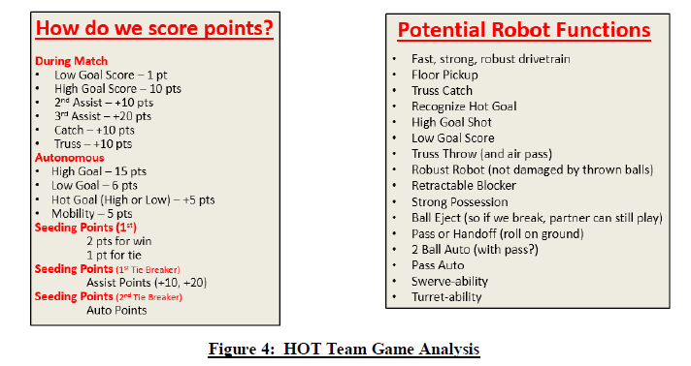
“HOT” Team #67 Perennial Top Team: Their Evaluation of 2014 game

Slide 14
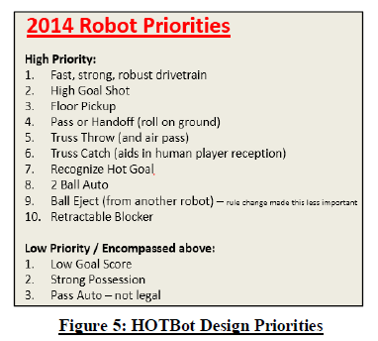
“HOT” Team #67 Perennial Top Team: Their 2014 Evaluation

Slide 15


Intro to Design Guide -
Senior group of technical mentors now has amassed over 40 years of FRC experience
Over 150 combined years of engineering experience
9 Seasons experience of what we have done successfully, what were “busts” and what we practically can make with our shop equipment and manufacturing capabilities

Slide 16
Purpose of this Guide
  Share understanding of our capabilities, materials, mechanisms and prior solutions that have been implemented by our team successfully.
Guiding Principles:
  Utilize team’s past competencies around Design, Methods and Material Selection
  Preference to use known materials and techniques when possible/appropriate
  Reserve new learning to address unique game needs
    You do not have to stay within the defined set for everything – but anticipate it will take longer – and the benefits need to warrant it.
    But challenge our norms to improve them
Goal:
Having the bulk of the team understand our standards enables higher quality discussions about design strategy.

Slide 17

What is an FRC Competition Robot ?
A complex System comprised of (typically):
  Drive Chassis system—Chassis, Wheels, Motors, Transmissions
    Most important sub-system
    if effective , you will play the game
  Game-piece intake system
  Game-piece deployment/manipulation system
  Unique subsystem (e.g. Hooks, 10 pt. hanger, ramp knockdown)
  Efficiently integrated to work together reliably, and easy to maintain.
Build from our base of experience, then add to it

Slide 18
Drive Chassis Systems TYPES
Tank
Swerve
Meccanum
Slide
Holonomic

Slide 19
Drive Chassis Systems
Tank
Left and right wheel(s) are driven independently
Simple & cheap to design, build, and program
Easy to drive
Potential for high speed and/or pushing force
Less agile than other drivetrains – depends on set up:
  Agility or ability to turn easily requires the ratio of wheel base Width over Length of the driving wheels to be W/L = ~1.5-2.0
  This is achieved by dropping the center wheel 1/8” or less so that only 4 driving wheels are touching ground at a time
Length
Width
Center wheel dropped 1/8” (or less)

Slide 20
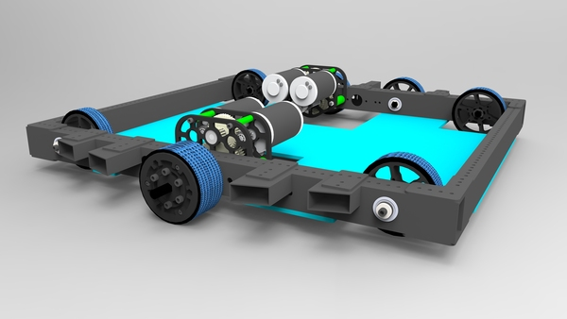
Drive Chassis Systems
Tank – variants
“West Coast Drive” (light weight – cantilevered wheels) set up for 6wd or 8wd
Dual Speed gearbox
“Hexagonal” floor plan (after bumpers added)
  Teams using that to help counteract T-bone defense – can have adverse effects.
8wd set up
6wd set up
Team 649 offseason project
See team 971 vs. 1114 Tboning examples
https://www.youtube.com/watch?v=G07Ci0VcUjs&feature=youtu.be&t=40s

Slide 21
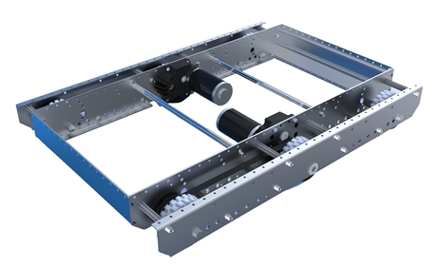
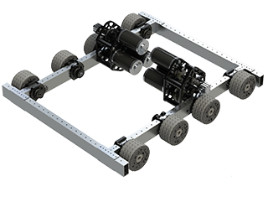
COTs – Tank Drivetrains
AndyMark
KOP Drivetrain – 2014
Upgrade Packages
VEXpro VersaChassis
Versa Frame - Bearing Blocks
2 Speed WCP or VP gearbox
Customizable/Upgradable
(Slide material taken from J.Foss NEFIRST University Pitch)

Slide 22
Wheels and Wheel-Base
Smaller wheels allow longer wheelbase and stability
  Also means less gear reduction from CIMs, lighter weight
  Larger wheels can go over rougher terrain more smoothly

Slide 23
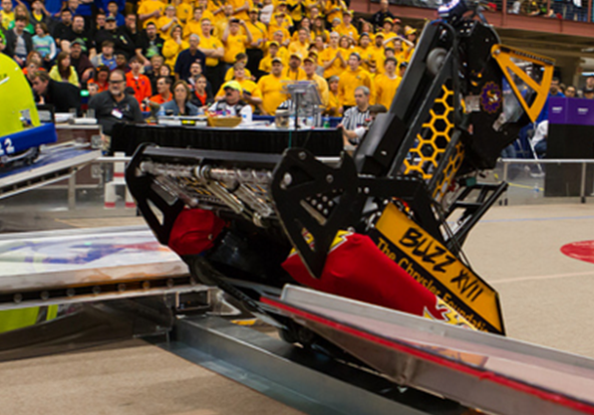
Bump Traverse
Big wheels not the only way to get over bumps!
Team 33 in 2012:
  Drop down wedge in front
  Feature to already deployed harvester
  Bumpers also used as part of “wedge”
    Bumpers within 2” of floor (low c.g.)
How 1717 got over bump with small wheels in 2012?
1:12 in: https://www.youtube.com/watch?v=rVDy4-b_hxo
4” tall
4” tall
2012 bump

Slide 24
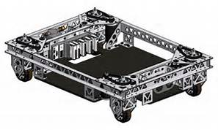
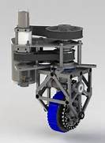
Drive Chassis Systems
Swerve
  Used past two years – works well provided gyro is reliable https://www.youtube.com/watch?v=02sxQ85vTrU
    Great for maneuverability, evasive ability and alignment
    Good traction – all energy in direction desired
    Harder to implement 2 speed
  For us, based off of experience, it is not hard to design/make and not expensive due to re-use of many COTs parts
    Need plates with holes made using NC mill
Pictures of team 1640’s swerve

Slide 25
Fully Independent Swerve Drive Allows Strafe + Rotation
“Superposition” – Vector Addition
+
=
Strafe
Rotate
Fully Independent Swerve
Each wheel to be driven and steered independently,
Also able to turn infinite rotations
8 motors required, requires 4 PID Feedback controls

Slide 26
Fully Independent Swerve Drive Allows Strafe + Rotation
“Superposition” – Vector Addition
+
=
Strafe
Rotate
Fully Independent Swerve
Each wheel to be driven and steered independently,
Also able to turn infinite rotations
8 motors required, requires 4 PID Feedback controls
Swerve Development Video

Slide 27
On Board “Gyro” Allows “Field Centric” driving
This makes Swerve very easy to drive for many candidates
How does a gyro work?
Why is it easier to ride a bike in motion than to balance on one not moving?

Slide 28
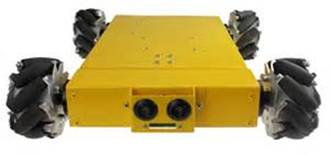
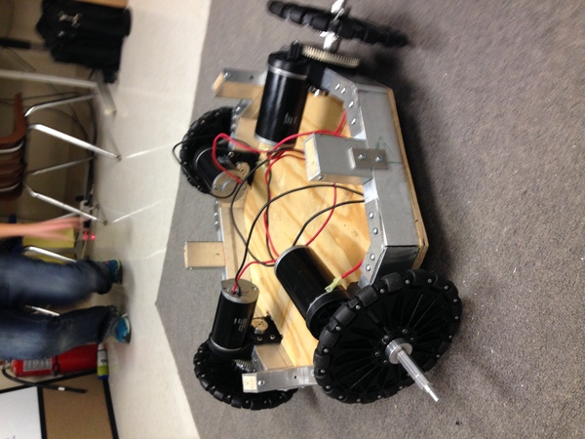
Drive Chassis Systems - Others
Slide
4+1 Omnis – maneuverable
Meccanum
Maneuverable, simple to implement
Holonomic Omni (3 or 4 wheel)
Maneuverable, light
All of these are poor at traction
Usually does not trade - 2015 was unusual
(Hybrid systems try to overcome traction shortfall)

Slide 29
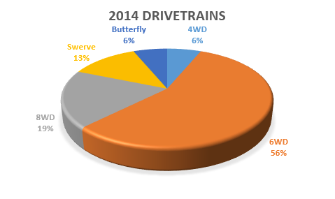
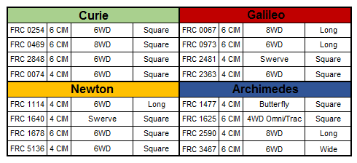
History Lesson: Einstein Drivetrains 2014
(Slide material taken from J. Foss Team 558, NEFIRST University Pitch)

Slide 30
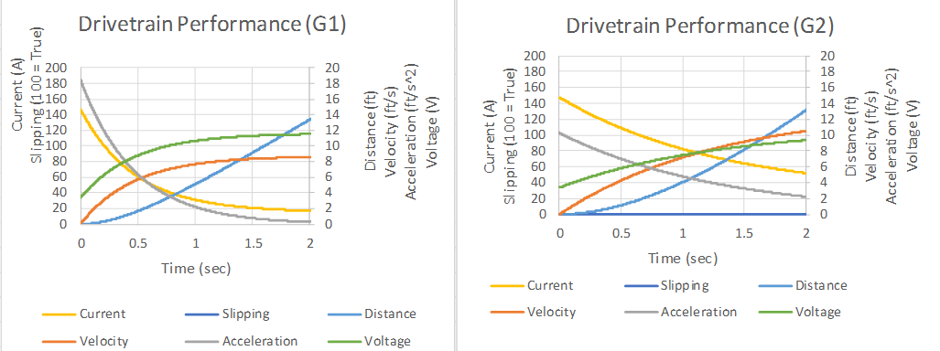

Transmission Gear Ratio(s)
Gear ratio selection critical to having a good performing drivetrain
Too High a ratio and your robot will be plodding about as others circle you
Too Low a ratio and you will have poor acceleration and be pushed about, and you will probably never achieve your top speed (like on a shifting bicycle?)
  Consider amount of pushing, control and distance to be travelled when optimizing ratios
    Also current draw – RoboRio less tolerant than 2014 cRio
  Design gearbox to allow for easy change of ratios if possible
How about 2 Speed? For another day.
Compare 2 Gear Ratios:
  10:1 and 6:1
Which gets to higher speed?
Which gets further in 2 seconds?
in 1 sec?
Which will push harder?
Which is easier on batteries?

Slide 31
Transmission Gear Ratio(s)
Gear ratio selection critical to having a good performing drivetrain
Too High a ratio and your robot will be plodding about as others circle you
Too Low a ratio and you will have poor acceleration and be pushed about, and you will probably never achieve your top speed
For single speed our overall ratio of 6.61:1 between a CIM motor and a 4” wheel provided a nice balance for 2014, long runs of >20 ft.
But in 2015 it was too fast – and we dialed it back in software which hurt us in control on placing stacks on steps. A ratio of 8 or 9:1 would have been more suitable – optimizing for ~10 ft. and greater precision control required
  Consider amount of pushing, control and distance to be travelled when optimizing ratios
    Also current draw
  Design gearbox to allow for easy change of ratios if possible

Slide 32
Transmission Gear Ratio(s)
Spreadsheet assesses gear ratios, speed, distance, voltage and current
  Optimize time from A to B; not to top speed (which you may never achieve)
2 gear ratios simulated in spreadsheet above
  On left : 10:1 ratio gives a loaded top speed of 8.7 fps
  On right: 6:1 ratio gives a loaded top speed of 12 fps
  After 2 seconds both system have moved the robot the same distance: 13.5 ft.
  After 1 second the “slower” one has gone 5 ft., and the “faster” one has gone only 4 ft.!
  The one geared slower will have greater acceleration at the low end.
  Also means it will push better and use less current
For what distance do we optimize?
- game dependent

Slide 33
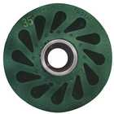
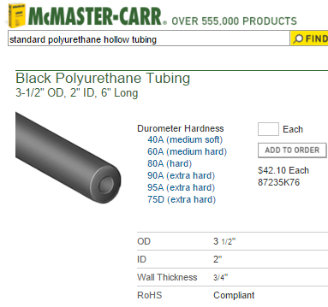
Intakes and Shooters
For Game-piece intake – every year (?) an active roller intake has been best
  We Touch it, We Own it!
    Exmples:
    https://www.youtube.com/watch?v=2Ek4aGRNess&feature=youtu.be&t=1m30s
    https://www.youtube.com/watch?v=jL6VtO5VSd8
For Game-piece deployment – shooters or placers – a roller has often (always?) been best
  May be wheels, rollers, tubing, often polyurethane
  Also poly-cord or flat polyurethane belting
  Spend lots of time prototyping, and optimizing
  Its all about level of pinch and speed
  Build/develop consistency from shot to shot
  Select motor/gearbox that gives 1.5x need
    Ability to vary ratios is great, and to change motor type
Durasoft wheels also available in 2.5” diameter!

Slide 34
Team 1114 “Weighted Objectives Table”
Use to clarify Decisions – here for Drive Train
Values below loaded by Team 1114 – Simbotics
  Typically game play concludes desire a strong, agile system that is intuitive to drive and will not overload the electrical system
Above values will tend to support a tank drive decision
But the values in the table can be influenced by prior projects gaining experience with other drives

Slide 35
Team 2067 Modified “Weighted Objectives Table”
Because of our experience with swerve drive, our values change in the table
Values below modified to reflect 2067 experience, as well as reflecting the recent motor rules that have made many more available & 6 CIM tank drive
Here two scenarios – one has a bump to traverse
Could swing decision depending on possible game and solutions.
  It’s more than the numbers – they just help you think through the problem
  In this case it may drive us to investigate alternate bump traverse options

Slide 36
Team 2067 Modified “Weighted Objectives Table”
A more likely, useful view comparison of drive types:
Weighting of values is game dependent

Slide 37
Intakes and Shooters
For Game-piece intake – every year (?) an active roller intake has been best
  We Touch it, We Own it!
For Game-piece deployment – shooters or placers – a roller has often (always?) been best
  May be wheels, rollers or belted conveyors
    Durometer matters
    Several top teams using polyurethane tubes
  Also poly-cord or flat polyurethane belting
Its all about level of pinch and speed
  Consistency from shot to shot
  Spend lots of time prototyping, and optimizing
  Select motor/gearbox that gives 2x need if possible
    Higher inertial wheel will not drop in speed as much
Durasoft wheels also available in 2.5” diameter!

Slide 38
Sensors and Control
Have sensors that tell what every actuator on the robot is doing:
  Position and/or speed
  Encoders and limit switches (including magnetic and light or IR sensors)
  Pneumatic pressure sensor
Have sensors that tell you where the robot is relative to key field or game elements:
  Encoders, Gyros, Ultrasonic rangefinders
Now can use feedback control to automate functions:
  Can help improve consistency
  Pressing one button starts a sequence of operations to execute a function
    Shooting Frisbees is a 5 step sequence
  Enables Autonomous routines

Slide 39
Sensors and Control
Have sensors that tell what every actuator on the robot is doing
  Position and/or speed
  Encoders and limit switches (including magnetic and light or IR sensors)
  Pneumatic pressure sensor
Have sensors that tell you where the robot is relative to key field or game elements
  Encoders, Gyros, Ultrasonic rangefinders
Now can use feedback control to automate functions
  Can help improve consistency
  Pressing one button starts a sequence of operations to execute a function
    Shooting frisbees
  Enables Autonomous routines

Slide 40
Similar to most varsity sports
Provide an environment to reward focus and dedication to the program
We want all to succeed!

Slide 41
Traveling with team to overnight events is special
Successful competitions requires focus & work; scouting, engaging with other teams is learning opportunity, pit crew, drive team
Not a vacation
“Earned Privilege!”
How to Earn?

Slide 42
We Have Had General Guidelines
  Attendance at Meetings (approx. 15%)
    Engagement while present
  Participation in Outreach, FUNdraising, Community activities
That was about it!

Slide 43
2016?
Name | Grade | Mech 2 | Mech 1 | Elect 2 | Elect 1 | CAD 2 | CAD 1 | LV 2 | LV 1 | Strat 2 | Strat 1 | Awards 4 | Awards 3 | Awards 2 | Awards 1 | Drive 2 | Drive 1 | Comm | Fundraiser | Outreach | Total x's
Joe | Sr | x | x | x | x | x | x |  | x | x | x | x | x | x | x |  |  |  |  | x | 15
Bob | Sr |  | x | x | x |  | x | x | x | x | x |  |  |  | x | x | x |  | x |  | 13
Ellen | Jr |  | x |  |  |  |  |  |  | x | x | x | x | x | x | x | x | x |  |  | 10
Barbara | Sr |  | x |  | x | x |  |  | x |  |  | x |  | x | x | x |  |  | x | x | 10
Harry | Sr | x | x |  | x | x |  | x | x |  |  |  |  | x | x |  |  |  |  |  | 9
Mary | Sr |  | x |  |  | x |  | x |  |  | x |  | x |  | x |  |  | x | x | x | 9
Jimmy | Fr |  | x |  |  | x | x |  |  | x | x |  |  |  | x |  |  | x | x | x | 9
Nellie | Fr |  |  |  | x |  |  |  | x | x | x |  |  |  | x | x |  | x | x | x | 9
Waldo | So |  | x | x | x |  |  |  | x | x |  |  |  | x |  |  | x |  | x |  | 8
Jerry | So |  |  |  | x |  |  |  | x |  |  |  | x | x | x |  |  | x | x | x | 8
Suzy | Sr |  | x |  | x |  |  |  |  |  |  |  | x | x | x |  |  | x | x | x | 8
Linda | So |  | x |  | x |  | x |  |  |  | x |  |  | x |  |  |  | x | x | x | 8
Billy | So |  | x |  | x |  | x |  |  |  |  |  |  |  | x |  | x | x | x | x | 8
 | Fr |  | x |  |  |  | x |  |  |  |  |  | x | x |  |  | x | x | x | x | 8
 | Sr | x | x |  | x | x |  |  |  |  | x |  |  | x |  |  |  |  | x |  | 7
 | Sr |  | x |  | x | x |  | x |  |  |  |  |  |  |  |  |  | x | x | x | 7
 | So |  | x |  | x |  |  |  |  |  |  |  | x |  | x |  |  | x | x | x | 7
 | Sr |  |  |  | x |  | x |  |  |  |  |  | x |  | x |  |  | x | x | x | 7

Slide 44
2016?
Electrical 1 | Some prior electrical or successfully completed the arduino course
 | Sustains interest in learning and doing more
Electrical 2 | Ability to wire the FRC robot control system, including sensors.
 | Excellent attention to detail, neat wiring
CAD 1 | Completed Mr Gresham's CAD training or prior demonstration
 | Continuing to develop capability on own initiative
CAD 2 | CAD something for Competition Robot
 | Help CAD Drive system in 1st 2 weeks.
LV 1 | Completed intro to labview training
 | Developing further through indep study and shop opportunities
LV 2 | Contributed to code on competition robot, proficient on sensors.
 | Leads others to better understand Labview and robot control logic.
Strat 1 | Strategist during matches, pick list, scout lead, or game design at KO.
 | Monitors FRC news on Chief Delphi, Blue Alliance and other.
Strat 2 | Developed match/game/design strategy successfully deployed
 | Are keeping abreast of latest strategy trends etc around FRC.
Awards 1 | Attends organization sessions, contributes with ideas
 | May have helped an award in past
Awards 2 | Regular attendee and contributor
 | Safety Captain

Slide 45
WPI Event - March 11-13 (Friday-Sunday)
Rhode Island Event – March 24-26 (Thurs.-Saturday)
Hartford Event – April 1-3 (Friday-Sunday)
If we qualify -
New England District Hartford XL Center –
April 13-16 (Weds.- Saturday)

Slide 46
Two shift arrangement for shop work
Weekdays (Monday – Thurs)
      First shift, 5pm – 6:45pm
      Second shift, 6:45pm – 8:30pm
Weekends
      Saturday, 9am – 12 noon, 1pm – 4pm
      Sunday, 10am - 1pm, 2pm – 5pm
Signups through Google Docs –Look for Sean’s email

Slide 47
Dedicated workstations
      No need to put components away
Tools must still be put away
      End of each day
Shop needs to remain clean & orderly
      Largely students responsibility
      Sometimes first shift – sometimes second

Slide 48
Before Saturday –
Read the 2015 Game Manual
      Game, Robot, Arena
  Get Signed up in Google Docs
  Decide how you will display your concepts (Monday/Tuesday)
      CAD, SketchUp, Excel Drawing,
      “scribble” should not be an option
  Bring your laptop (if you have one), writing instrument, notepad

Slide 50
That’s All Folks!
See You Saturday! Get Ready!

